Slide 1
Next Generation Sequencing – An Overview
Olga Vinnere Pettersson, PhD
National Genomics Infrastructure hosted by ScilifeLab,
Uppsala Node (UGC)
Version 6.1

Slide 2
Outline:
www.robustpm.com
4 slides about history
NGS technologies
NGS applications
NGS sample quality requirements
Philosophical reflection
National Genomics Infrastructure – Sweden

Slide 3
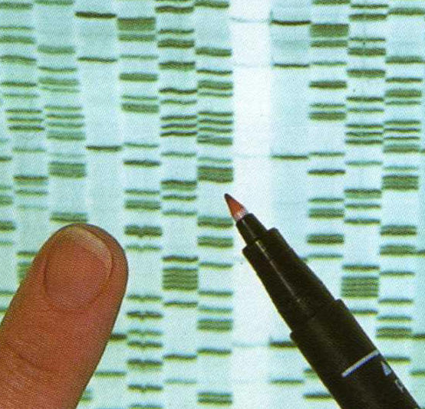
Once upon a time…
Fredrik Sanger and Alan Coulson
Chain Termination Sequencing (1977)
Nobel prize 1980
Principle:
SYNTHESIS of DNA is randomly TERMINATED at different points
Separation of fragments that are 1 nucleotide different in size

Slide 4
Sequencing genomes using Sanger’s method
Extract & purify genomic DNA
Fragmentation
Make a clone library
Sequence clones
Align sequencies ( -> contigs -> scaffolds)
Close the gaps
Cost/Mb=1000 $, and it takes TIME

Slide 5
DNA sequencing revolution - Sweden
Massively parallel sequencing (454, Illumina, Life Tech)
Human genome
James Watsons genome
Center for Metagenomic
Sequence Analysis (KAW)
National Genomics Infrastructure
(NGI)
Science for Life
Laboratory (SciLifeLab)
Notes:
Tight schedule, Lunch (wrap) at level 2, Dinner at level 2, speakers hand in USB, Thanks to Anders Andersson

Slide 6
Workload at NGI – Sweden 2010-2014

Slide 7
NGS technologies
Company | Platform | Amplification | Sequencing method
Roche | 454 (until 2016) | emPCR | Pyrosequencing
Illumina | HiSeq, MiSeq NextSeq, X10 | Bridge PCR | Synthesis
LifeTechnologies(Thermo Fisher) | Ion Torrent, Ion Proton, S5 | emPCR | Synthesis (pH)
Pacific Biosciences | RSII | None | Synthesis (SMRT)
Complete genomics | Nanoballs | None | Ligation
Oxford Nanopore* | MinION GridION | None | Flow
RIP technologies: Helicos, Polonator, SOLiD, 454 etc.
In development: Tunneling currents, nanopores, etc.

Slide 8
Differences between platforms
Technology: chemistry + signal detection
Run times vary from hours to days
Production range from Mb to Gb
Read length from <100 bp to > 20 Kbp
Accuracy per base from 0.1% to 15%
Cost per base

Slide 9
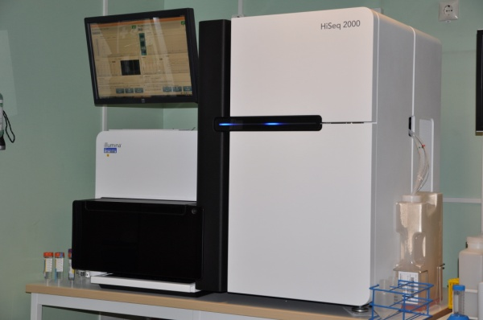
Illumina
Instrument | Yield and run time | Read Length | Error rate | Error type
HiSeq2500 | 120 Gb – 600 Gb 27h or standard run | 100x100 (250x250) | 0.1% | Subst
MiSeq | 540 Mb – 15 Gb (4 – 48 hours) | Up to 350x350 | 0.1% | Subst
HiSeqXten | 800 Gb - 1.8 Tb (3 days) | 150x150 | “ | “
Main applications
Whole genome, exome and targeted reseq
Transcriptome analyses
Methylome and ChiPSeq
Rapid targeted resequencing (MiSeq)
Human genome seq (Xten)

Slide 10
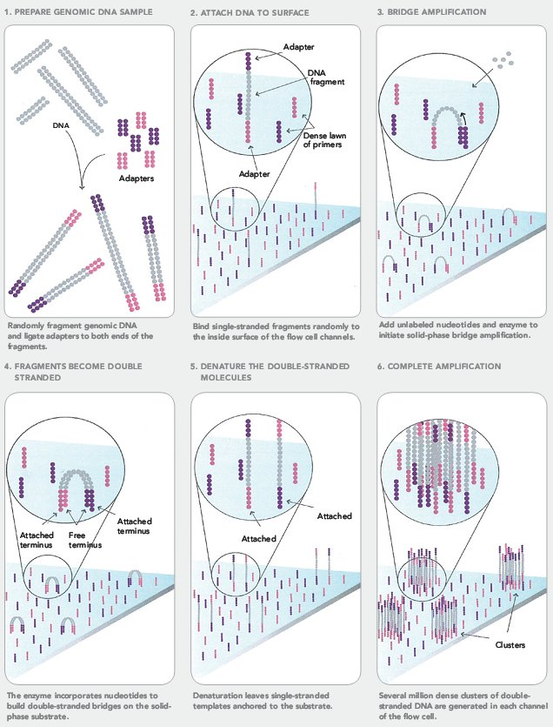
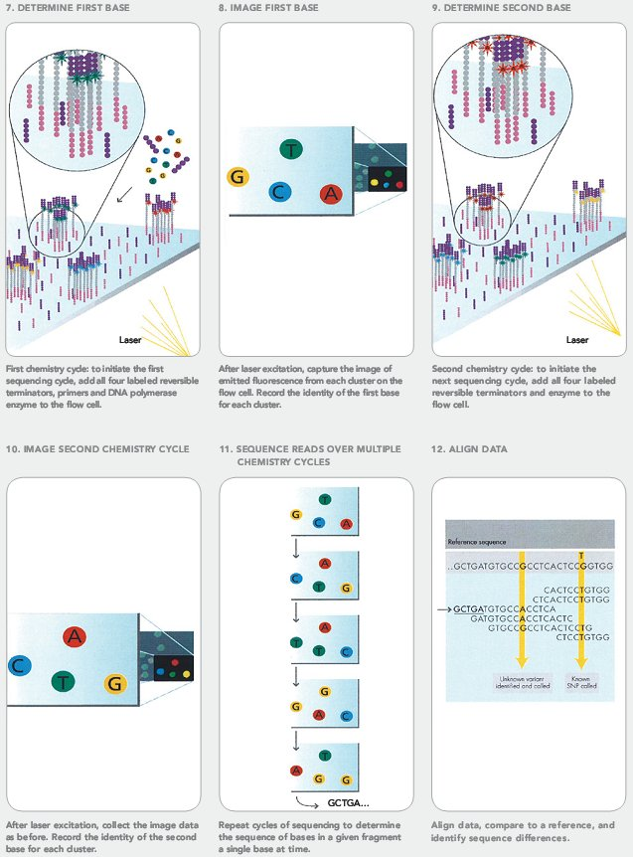
Illumina

Slide 11
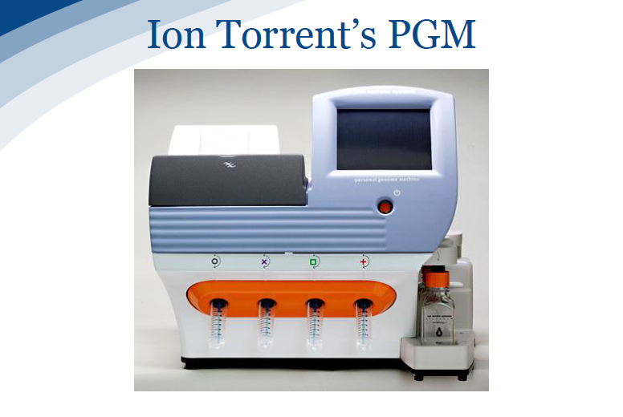
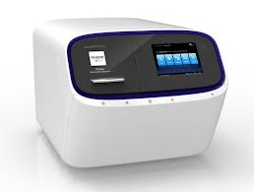
Life Technologies - Ion Torrent & Ion Proton
Chip | Yield - run time | Read Length
314, 316, 318 (PGM) | 0.1 – 1 Gb Gb, 3 hrs | 200 – 400 bp
P-I (Proton) | 10 Gb 4 hrs | 200 bp
520, 530, 540 (S5) | 1 Gb – 10 Gb 3 hrs | 400 bp (except 540)
Main applications
Microbial and metagenomic sequencing
Targeted re-sequencing (gene panels)
Clinical sequencing

Slide 12
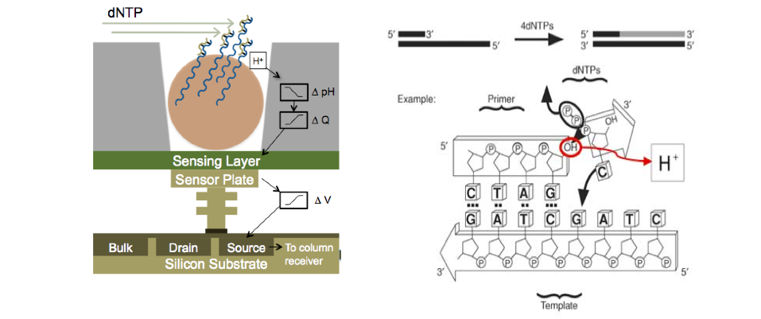
Ion Torrent - H⁺ ion-sensitive field effect transistors

Slide 13
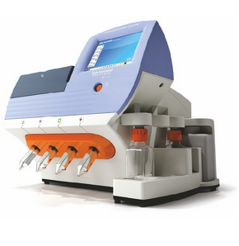
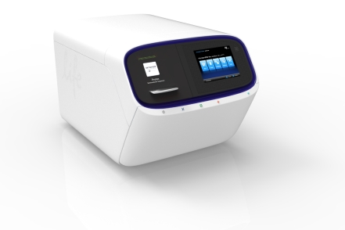
314 chip 316 chip 318 chip PI chip
10 Mb 100 Mb 1 Gb 10 Gb
200 – 400 bp
S5
200 bp
virus, bacteria, small eukaryote
eukaryote

Slide 14
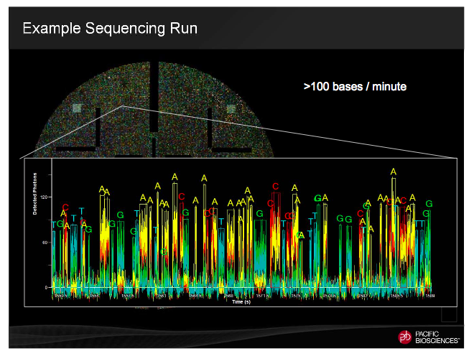
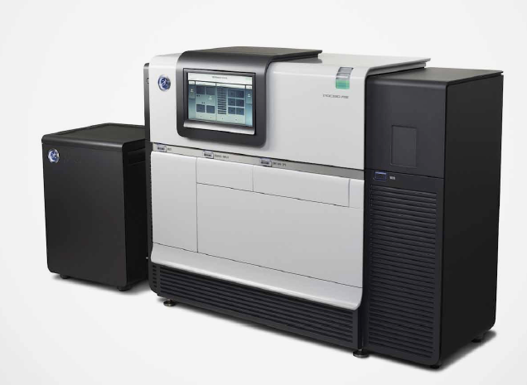
PacBio SMRT-technology
Instrument | Yield and run time | Read Length | Error rate | Error type
RS II | 250 Mb – 1.3 Gb /30 - 240 min SMRTCell | 250 bp – 30 000 bp (70 000 bp) | 15% (on a single passage!) | Insertions, random
Single-Molecule, Real-Time DNA sequencing

Slide 15
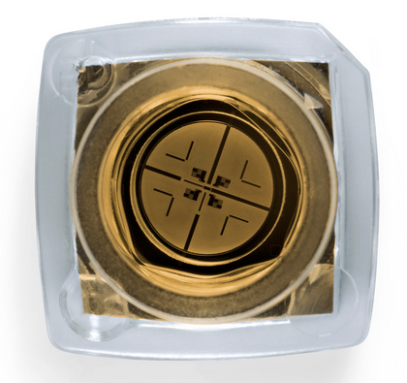
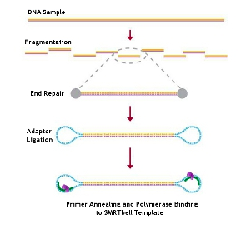
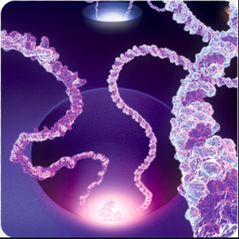
PacBio SMRT - technology
Single Molecule Real Time

Slide 17
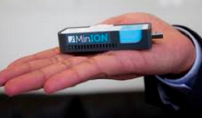
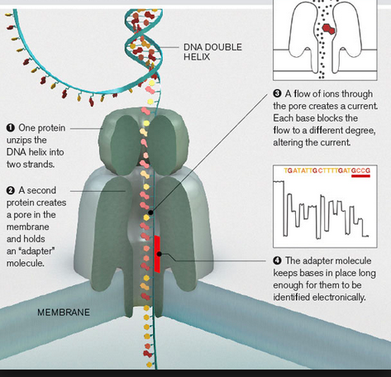
Oxford Nanopore MinION
Reads up to 100k
1D and 2D reads
15-40% error rate
Life time 5 days

Slide 18
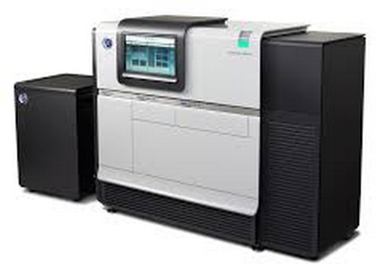
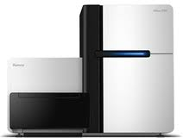
Main types of equipment
PacBio RSII
Ultra-long reads
FAST throughput
Illumina HiSeq
Illumina Xten
Illumina MiSeq
Short paired reads
HIGH throughput
Ion Torrent PGM
Ion Proton
Ion S5 XL
Short single-end reads
FAST throughput

Slide 19
NGS/MPS applications
Whole genome sequencing:
De novo sequencing
Re-sequencing
Transcriptome sequencing:
mRNA-seq
miRNA
Isoform discovery
Target re-sequencing
Exome
Large portions of a genome
Gene panels
Amplicons

Slide 20
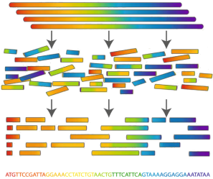
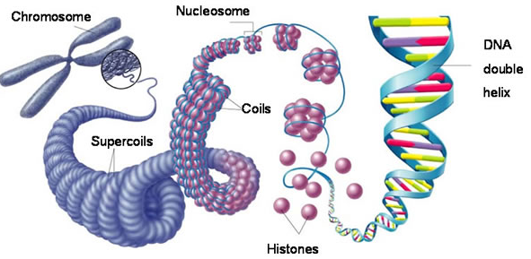
De novo sequencing
Used to create a reference genome without previous reference

Slide 21
De novo sequencing:
Illumina strategy
Sequencing:
PE library with 350 bp
PE library with 600 bp
MP library with 2 kb
MP library with 5-8-20 kb
PE: 50-100x, MP 10-15x
Analysis:
ALLPATH
PacBio strategy
Sequencing:
10-20 kb library
50-80x
(where 30x are reads above 10 kb)
Analysis:
HGAP (haploid)
FALCON (diploid)

Slide 22
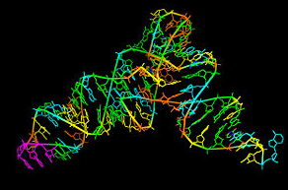
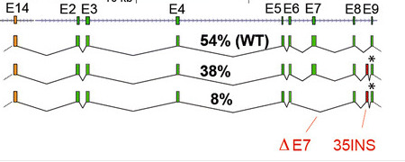
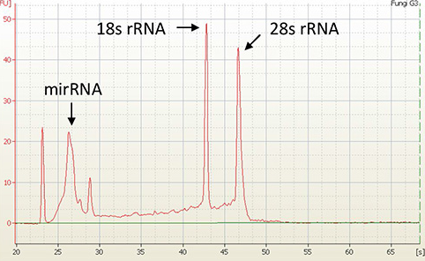
Transcriptome sequencing (RNA-seq)
TOTAL RNA
mRNA
Dif.ex.
Annotation
Splice isoforms
Non-codingRNA
miRNA
Transcriptional regulation

Slide 23
mRNA: rRNA depletion vs polyA selection
Method | Pros | Cons | Recommended
rRNA depletion | Captures on-going transcription Picks up non-coding RNA | Does not get rid of all rRNA Messy Dif.Ex. profile | 20-40 mln reads (single or PE)
polyA selection | Gives a clean Dif.Ex. profile | Does not pick non-coding RNA | 5-20 mln reads
Alternative for human RNA-seq:
AmpliSeq Human Transcriptome panel:
faster, cheaper, works fine with FFPE
input: 50 ng total RNA
dif.ex. ONLY

Slide 24
RNA-seq Equipment-related bias
De novo transcriptome: Illumina PE only
RNA-seq with a good reference:
Illumina 50 bp single end for Dif. Ex.
Illumina PE for splice information
Ion Proton single end in both cases
miRNA: Illumina or IonProton, but stick to the same technology through the project!

Slide 25
RNA-seq experimental setup
mRNA only: any kit
mRNA and miRNA: only specialized kits
Always use DNase!
RIN value above 8.
CONTROL vs experimental conditions
Biological replicates: 4 strongly recommended

Slide 26
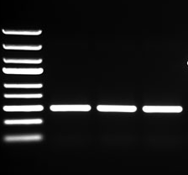
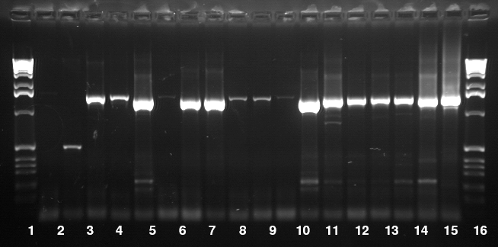
Amplicon sequencing
Used a lot in metagenomics
rRNA genes & spacers (16S, ITS)
Functional genes
Genotyping by sequencing

Slide 27
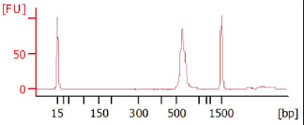
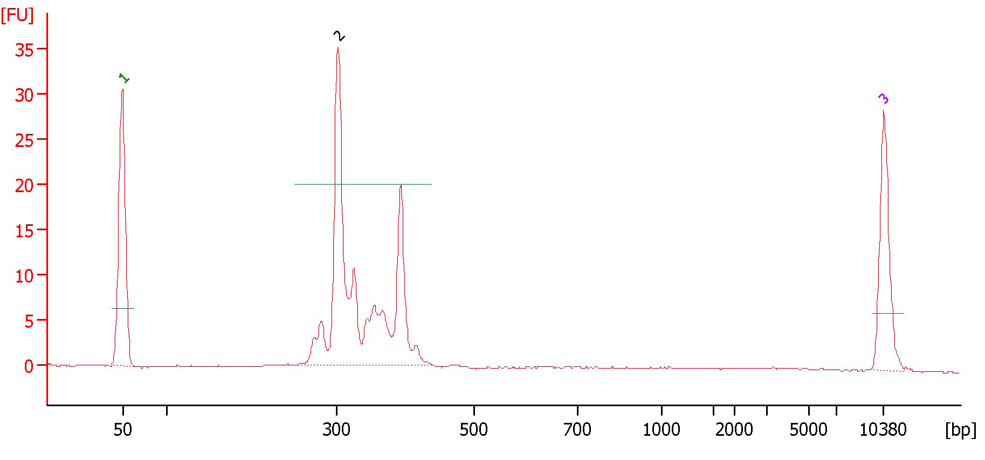
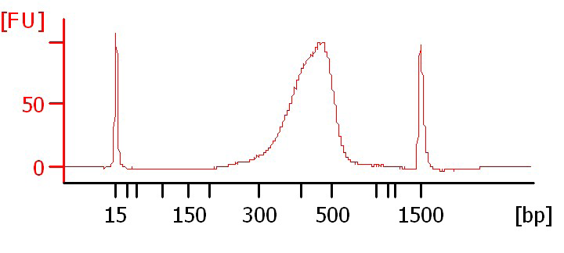
Amplicon sequencing
Example 1: tight peak, OK
FOR ANY NGS TECHNOLOGY
Size difference among fragments must not
exceed 80 bp (or 20% in length)
Reason – preferential amplification of short fragments
Example 2: several sizes,
fractionation is needed
=> we HAVE to make several libraries
Example 3: broad peak;
size selection is needed
SIZE MATTERS…

Slide 28
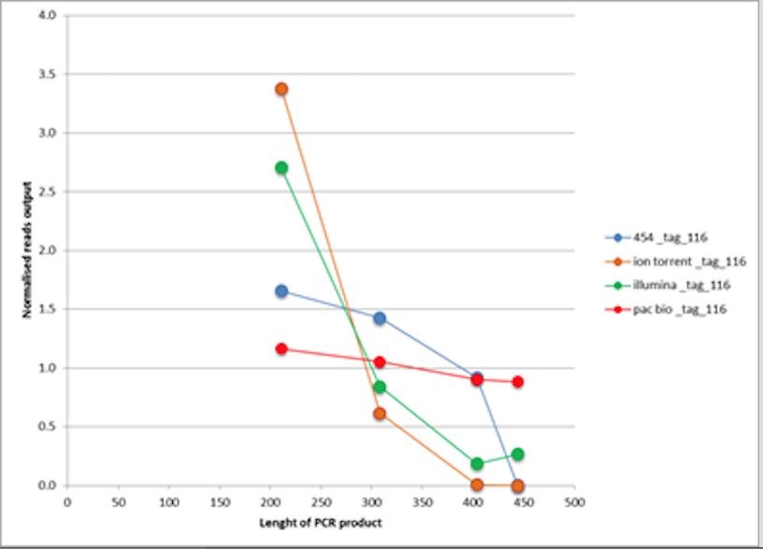
Size-related bias in amplicon-seq
Courtesy Mikael Brandström Durling, Forest Mycology and Pathology, SLU

Slide 29
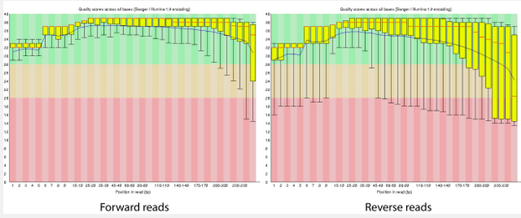
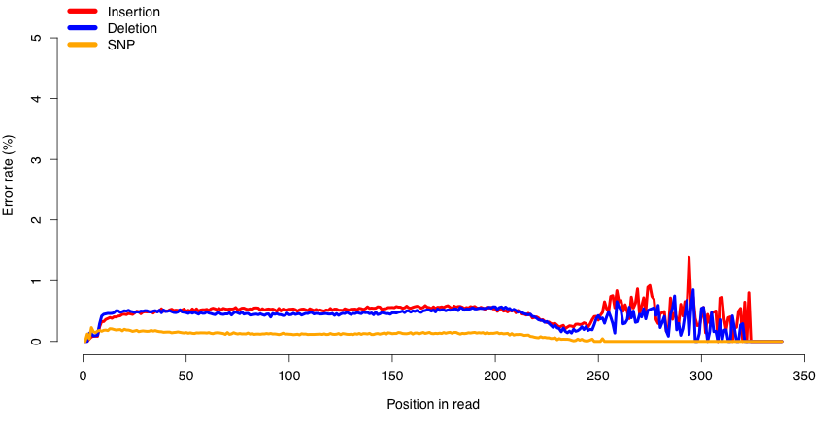
When you sequence an amplicon…
On MiSeq
FW read
RW read
On Ion
FW read

Slide 30
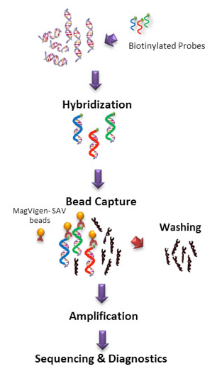
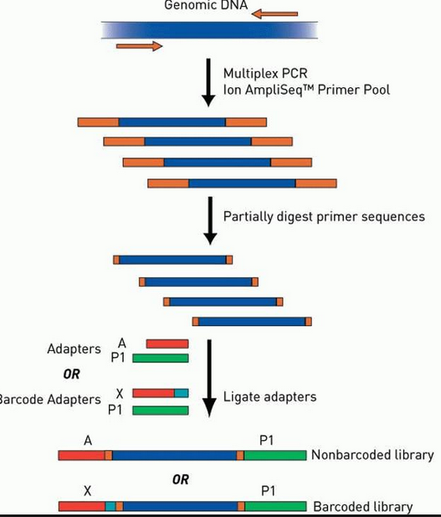
Sequence capture
When you are not interested in the entire genome:
Exome
Regions of interest
Genes of interest (gene panels)
Hybridization-based capture
PCR-based capture

Slide 31
Sequence capture: technology choice
AmpliSeq panels (multiplex PCR) – Ion Only
Comprehensive Cancer panel
Cancer Hotspot panel
AmpliSeq Human Exome, etc
AmpliSeq Human Transcriptome
Hybridization-based: any technology
Non-multiplex PCR – any technology
Short reads (up to 500 bp) – Illumina
Medium reads (up to 500 bp) – Ion
Long reads (from 500 bp – 20 kb) - PacBio

Slide 32
Main types of equipment & applications
Illumina HiSeq
Illumina Xten
Illumina MiSeq
Short paired reads
HIGH throughput
Human WGS
mRNA and miRNA
De novo transcriptome
Exome
ChIP-seq
Short amplicons
Methylation
Ion Torrent PGM
Ion Proton
Ion S5 XL
Short single-end reads
FAST throughput
mRNA and miRNA
Exome
ChIP-seq
Short amplicons
Gene panels
Clinical samples
PacBio RSII
Ultra-long reads
FAST throughput
Long amplicons
Re-sequencing
De novo sequencing
Novel isoform discovery
Fusion transcript analysis
Haplotype phasing
Clinical samples

Slide 33
What is The BEST?

Slide 34
SAMPLE QUALITY REQUIREMENTS

Slide 35
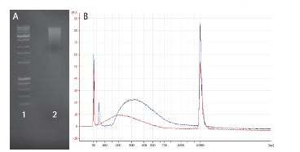
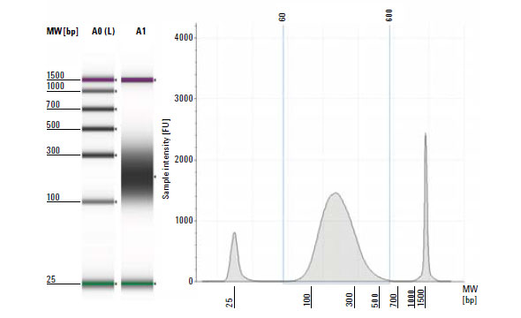
Making an NGS library
DNA QC – paramount importance
Sharing & size selection
Amplification
Ligation of sequencing adaptors, technology specific

Slide 36
Garbage in – garbage out: sequencing success to 90% depends on the sample quality
Before samples are submitted:
Send us the gel picture (DNA)
260/280 and 260/230 readings (DNA)
BioAnalyzer readings (RNA)

Slide 37
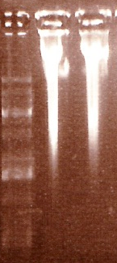
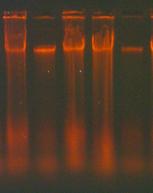
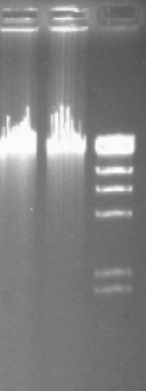
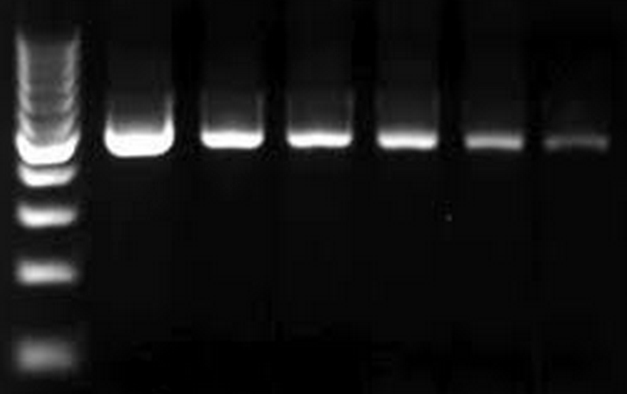
Reading gel pictures of genomic DNA
Protein contamination
- Apply phenol-chloroform
RNA contamination
- Apply RNase, followed
by phenol-chloroform
extraction
Phenol carry-over or
overloaded sample?
If unsure, make dilution series.
If problem persists – try MoBio clean-up kit,
or re-extract DNA

Slide 38
What do absorption ratios tell us?
Pure DNA 260/280: 1.8 – 2.0
< 1.8:
Too little DNA compared to other components of the solution; presence of organic contaminants: proteins and phenol; glycogen - absorb at 280 nm.
> 2.0:
High share of RNA.
Pure DNA 260/230: 2.0 – 2.2
<2.0:
Salt contamination, humic acids, peptides, aromatic compounds, polyphenols, urea, guanidine, thiocyanates (latter three are common kit components) – absorb at 230 nm.
>2.2:
High share of RNA, very high share of phenol, high turbidity, dirty instrument, wrong blank.
Photometrically active contaminants:
phenol, polyphenols, EDTA, thiocyanate, protein,
RNA, nucleotides (fragments below 5 bp)

Slide 39
How to make a correct measurement
Low concentration
High concentration
DNA
solution
Thaw DNA completely
Mix gently (never vortex!)
Put the sample on a thermoblock: 37°C, 15-30 min
Mix gently
Dilute 1:100 (if HMW)
Mix gently
Make a measurement with an appropriate blank
NANODROP is Bad.

Slide 40
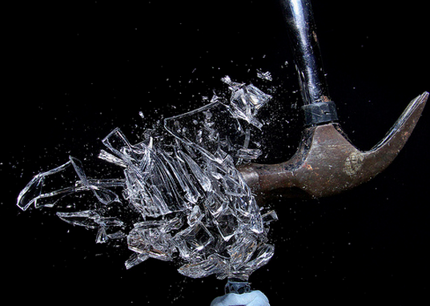
Sample prep: genomic DNA
Treat DNA as a crystal vase: it is fragile when in solution
As soon as DNA is released from the cells – use wide-bore tips
Limit pipetting to minimum
Always use RNase!
Never vortex!
Do not heat above 65°C
Reduce amount of freeze-thaw cycles to minimum
Make several aliquotes of the stock DNA

Slide 41
Sample prep: take home message
PCR-quality sample and
NGS-quality sample
are two completely different things

Slide 42
Sample prep: RNA
mRNA degrades FAST
Freeze sample or place it in RNA-later within 30 sec (if possible)
If going for miRNA seq – chose a correct kit!
Always treat samples with DNase
Differential expression, miRNA – RIN value over 8.0
Aim for 4 biological replicates

Slide 43
Let’s get philosophical

Slide 44
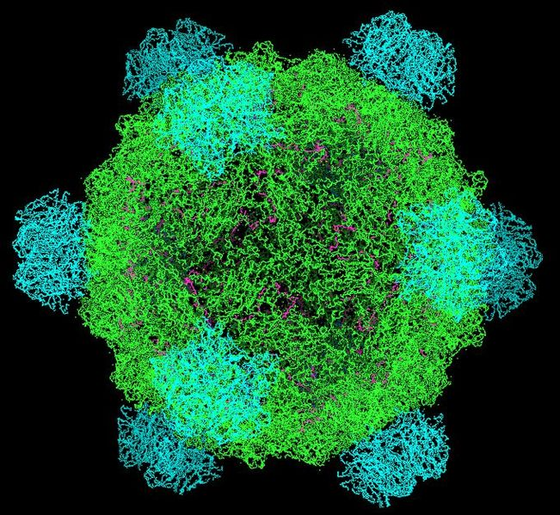
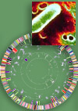
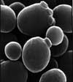
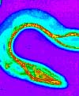
Since the beginning of Genomics:
First genome: virus φ X 174 - 5 368 bp (1977)
First organism: Haemophilus influenzae - 1.5 Mb (1995)
First eukaryote: Saccharomyces cerevisiae - 12.4 Mb (1996)
First multicellular organism: Cenorhabditis elegans - 100 MB (1998-2002)
First plant: Arabidopsis thaliana - 157 Mb (2000)

Slide 45
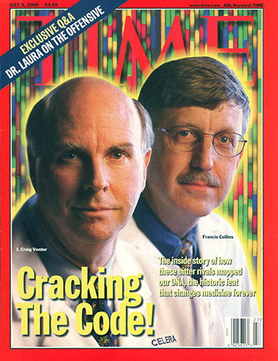
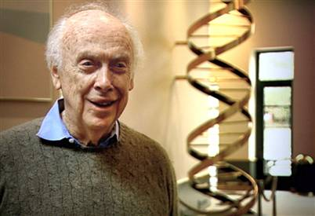
… prices go down
Human genome project, 2007
Genome of Craig Wenter costs 70 mln $
Sanger’s sequencing
Genome of James Watson costs 2 mln $
454 pyrosequencing
Ultimate goal: 1000 $ / individual
Almost there! (1200 $)

Slide 46
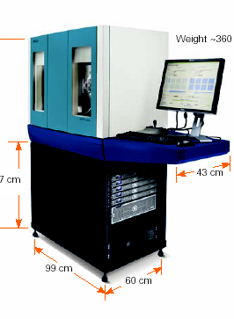
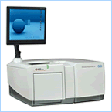
… paradigm change
From single genes to complete genomes
From single transcripts to whole transcriptomes
From single organisms to complex metagenomic pools
From model organisms to the species you are studying
Personal genome = personalized medicine

Slide 47
… scientific value diminishes
IF 31.6
IF 2.9

Slide 48
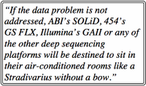
Main challenge - DATA ANALYSIS and DATA STORAGE
!
Data analysis
$
http://finchtalk.geospiza.com
Sequencing
=> More bioinformaticians to people!

Slide 49
NGI-portal

Slide 50
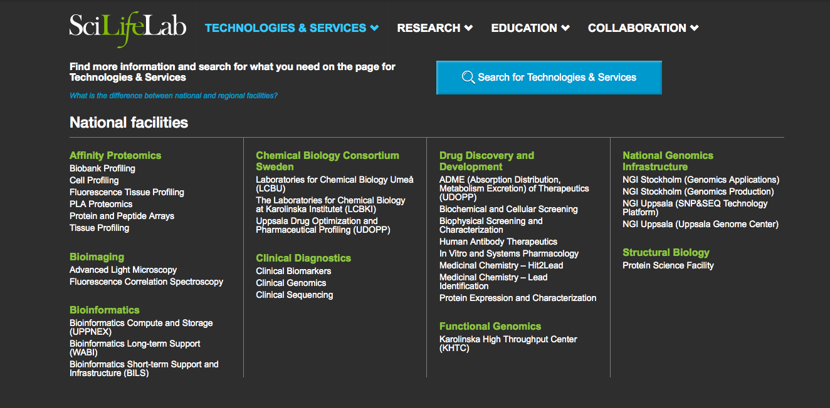

Slide 51
National Genomics Infrastructure
SciLifeLab, Stockholm
SciLifeLab, Uppsala
Mid 2010
Uppmax, Uppsala

Slide 52
NGI-SciLifeLab is one of the most well-equipped
NGS sites in Europe
10 Illumina HiSeq Xten
17 Illumina HiSeq 2000/2500
3 Illumina MiSeq
1 Illumina NextSeq
2 Life Technologies Ion Torrent
6 Life Technologies Ion Proton
2 Pacific Biosciences RSII
2 Sanger ABI3730
1 Argus Whole Genome Map. Syst.
2 Oxford Nanopore MinIon
Notes:
NGI is one of the most well equipped NGS site in Europe. We use different technologies which makes it possible to find most appropriate solution for different type of projects
52

Slide 53
https://portal.scilifelab.se/genomics

Slide 54
What happens then?
NGI Project coordinators meet twice a week via Skype
Ulrika Ellenor
Liljedahl Devine
SNP&SEQ, Uppsala node
Mattias Beata
Ormestad Werne Solenstam
Stockholm Node
Olga
Vinnere Pettersson
UGC, Uppsala Node
Project distribution is based on:
Wish of PI
Type of sequencing technology
Type of application
Queue at technology platforms
Project is then assigned to a certain node and a coordinator contacts the PI

Slide 55
Projects at CMS
3. Access to genomics platform
Project meeting
What we can help you with:
Design your experiment based on the scientific question.
Chose the best suited application for your project.
Find the most optimal sequencing setup.
Answer all questions about our technologies and applications, as well as bioinformatics.
In special cases, we can give extra-support with bioinformatics analysis – development of novel methods and applications

Slide 56
QUESTIONS?

Slide 57
Downstream Data Analysis
Bioinformatics competence IS NOT present in research group
Bioinformatics competence IS present in research group
Cooperation with platform personnel: R&D
BILS:
Bioinformatics Infrastructure
for Life
Sciences
WABI:
Wallenberg
Advanced
Bioinformatics
Initiative
Co-authorship
Short-term commitment
Long-term commitment

