Slide 1
Next Generation Sequencing – An Overview
Olga Vinnere Pettersson, PhD
National Genomics Infrastructure hosted by ScilifeLab,
Uppsala Node (UGC)
Version 5.2.3.d

Slide 2
Today we will talk about:
www.robustpm.com
History and current state of genomic research
Sequencing technologies:
Types
Principles (chemistry & workflow)
DNA quality requirements
Choosing the right technology
Couple of pieces of advise
National Genomics Infrastructure – Sweden

Slide 3
DNA sequencing revolution
Massively parallel sequencing (454, Illumina, Life Tech)
Human genome
James Watsons genome
Center for Metagenomic
Sequence Analysis (KAW)
Swedish National Infrastructure
for Large-Scale Sequencing
(SNISS)
Science for Life
Laboratory (SciLifeLab)
Notes:
Tight schedule, Lunch (wrap) at level 2, Dinner at level 2, speakers hand in USB, Thanks to Anders Andersson

Slide 4
Workload at NGI – Sweden 2010-2014

Slide 5
What is sequencing?

Slide 6
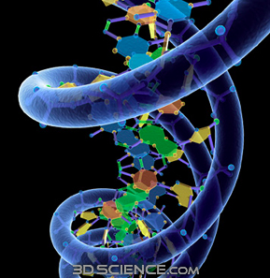
DEFINITION
“In genetics and biochemistry, sequencing means to determine the primary structure (or primary sequence) of an unbranched biopolymer.”
(http://en.wikipedia.org/wiki/Sequencing)

Slide 7
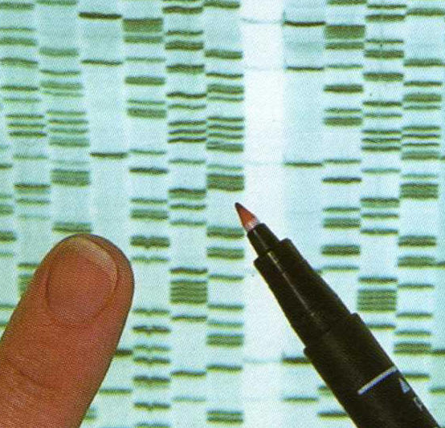
Once upon a time…
Fredrik Sanger and Alan Coulson
Chain Termination Sequencing (1977)
Nobel prize 1980
Principle:
SYNTHESIS of DNA is randomly TERMINATED at different points
Separation of fragments that are 1 nucleotide different in size

Slide 8
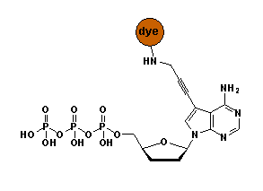
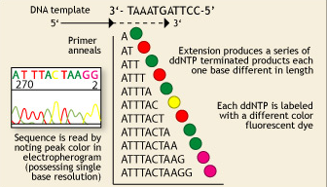
Sanger’s sequencing
P³² labelled ddNTPs
!
Lack of OH-group at 3’ position of deoxyribose
Fluorescent dye terminators
Max fragment length – 750 bp

Slide 9
Sequencing genomes using Sanger’s method
Extract & purify genomic DNA
Fragmentation
Make a clone library
Sequence clones
Align sequencies ( -> contigs -> scaffolds)
Close the gaps
Cost/Mb=1000 $, and it takes TIME

Slide 10
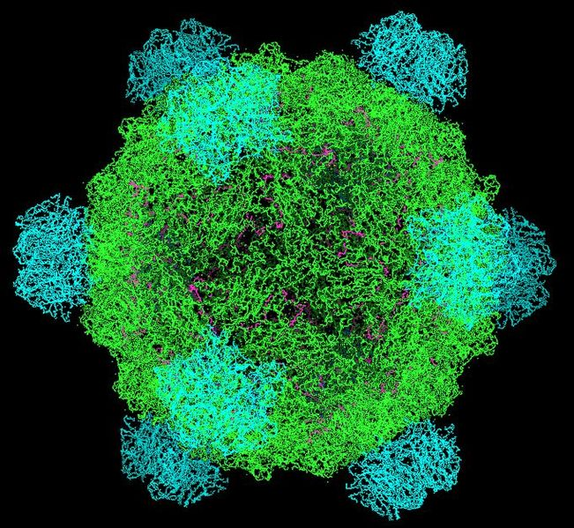
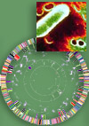
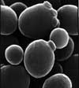
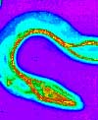
At the very beginning of genome sequencing era…
First genome: virus φ X 174 - 5 368 bp (1977)
First organism: Haemophilus influenzae - 1.5 Mb (1995)
First eukaryote: Saccharomyces cerevisiae - 12.4 Mb (1996)
First multicellular organism: Cenorhabditis elegans - 100 MB (1998-2002)
First plant: Arabidopsis thaliana - 157 Mb (2000)

Slide 11
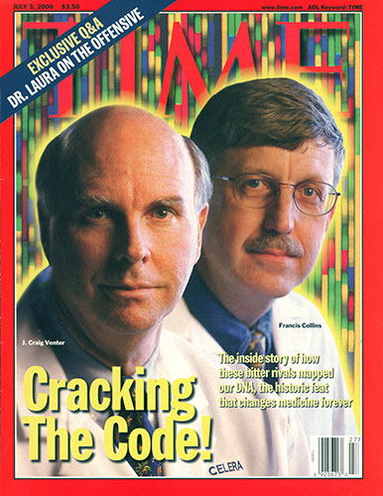
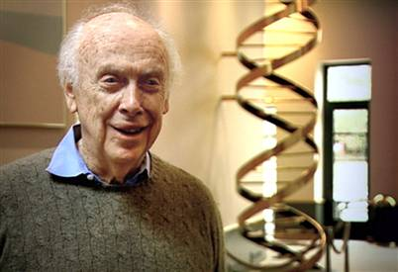
Just an interesting comparison:
Human genome project, 2007
Genome of Craig Wenter costs 70 mln $
Sanger’s sequencing
Genome of James Watson costs 2 mln $
454 pyrosequencing
Ultimate goal: 1000 $ / individual
Almost there! (1200 $)

Slide 12
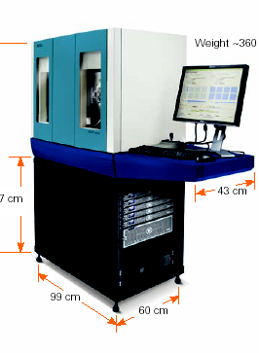
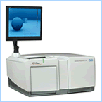
Paradigm change
From single genes to complete genomes
From single transcripts to whole transcriptomes
From single organisms to complex metagenomic pools
From model organisms to the species you are studying

Slide 13
IF 31.6
IF 2.9

Slide 14
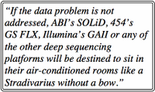
Main hazard - DATA ANALYSIS
!
Data analysis
$
http://finchtalk.geospiza.com
Sequencing
=> More bioinformaticians to people!

Slide 15
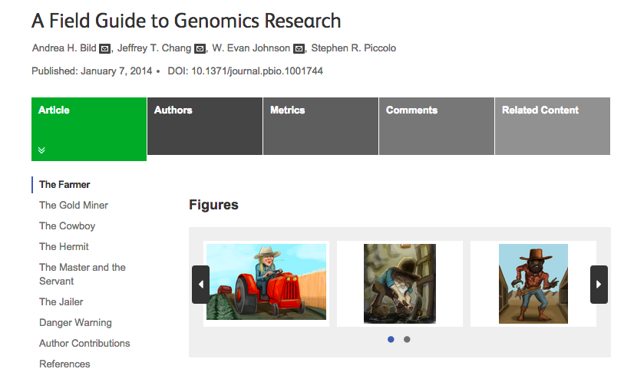
Recommended reading
http://journals.plos.org/plosbiology/article?id=10.1371/journal.pbio.1001744

Slide 16
Major NGS technologies

Slide 17
NGS technologies
Company | Platform | Amplification | Sequencing method
Roche | 454** | emPCR | Pyrosequencing
Illumina | HiSeq MiSeq | Bridge PCR | Synthesis
LifeTech | SOLiD** | emPCR/ Wildfire | Ligation
LifeTech | Ion Torrent Ion Proton | emPCR | Synthesis (pH)
Pacific Bioscience | RSII | None | Synthesis
Complete genomics | Nanoballs | None | Ligation
Oxford Nanopore* | GridION | None | Flow
RIP technologies: Helicos, Polonator, etc.
In development: Tunneling currents, nanopores, etc.

Slide 18
Differences between platforms
Technology: chemistry + signal detection
Run times vary from hours to days
Production range from Mb to Gb
Read length from <100 bp to > 20 Kbp
Accuracy per base from 0.1% to 15%
Cost per base varies

Slide 19
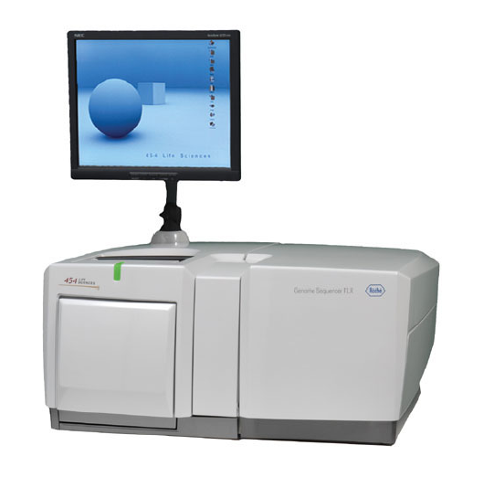
Roche
Instrument | Yield and run time | Read Length | Error rate | Error type
454 FLX+ | 0.9 GB, 20 hrs | 700 | 1% | Indels
454 FLX Titanium | 0.5 GB, 10 hrs | 450 | 1% | Indels
454 FLX Jr | 0.050 GB, 10 hrs | 400 | 1% | Indels
Main applications:
Microbial genomics and metagenomics
Targeted resequencing

Slide 20
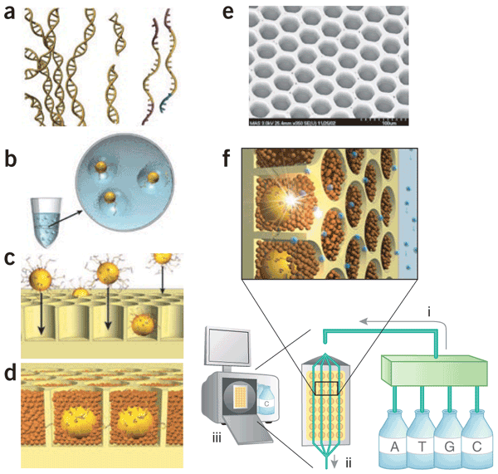
454 Titanium GS FLX

Slide 21
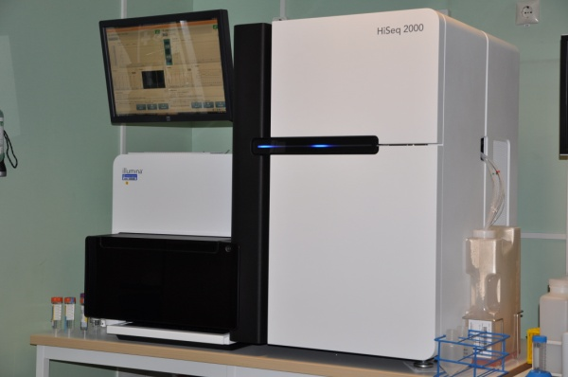
Illumina
Instrument | Yield and run time | Read Length | Error rate | Error type
HiSeq2500 | 120 Gb – 600 Gb 27h or standard run | 100x100 (250x250) | 0.1% | Subst
MiSeq | 540 Mb – 15 Gb (4 – 48 hours) | Up to 350x350 | 0.1% | Subst
HiSeqXten | 800 Gb - 1.8 Tb (3 days) | 150x150 | “ | “
Main applications
Whole genome, exome and targeted reseq
Transcriptome analyses
Methylome and ChiPSeq
Rapid targeted resequencing (MiSeq)
Human genome seq (Xten)

Slide 22
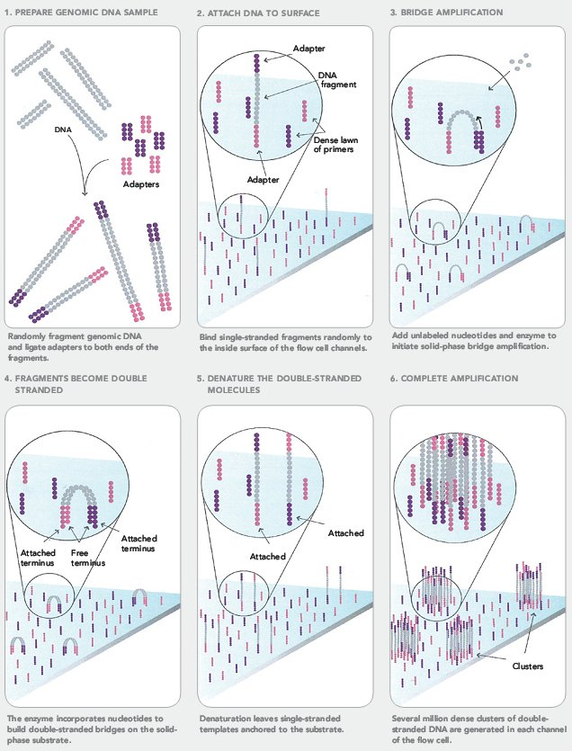
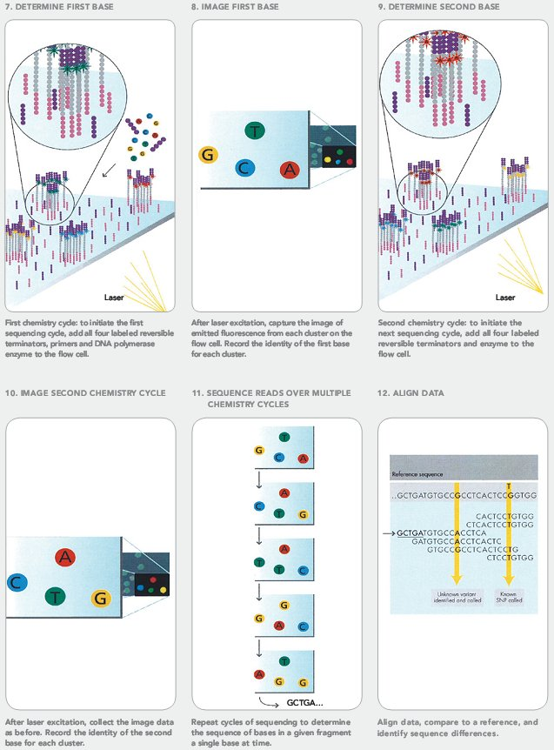
Illumina

Slide 23
Illumina reads
Paired-end sequencing
Read2
5’
3’
3’
5’
Read1
Index read
Illumina insert length: 180 – 300 – 670 bp
Notes:
I sekvensningen utförs 1-4 läsningar beroende på typ av sekvensning.
R1, I1, R2

Slide 24
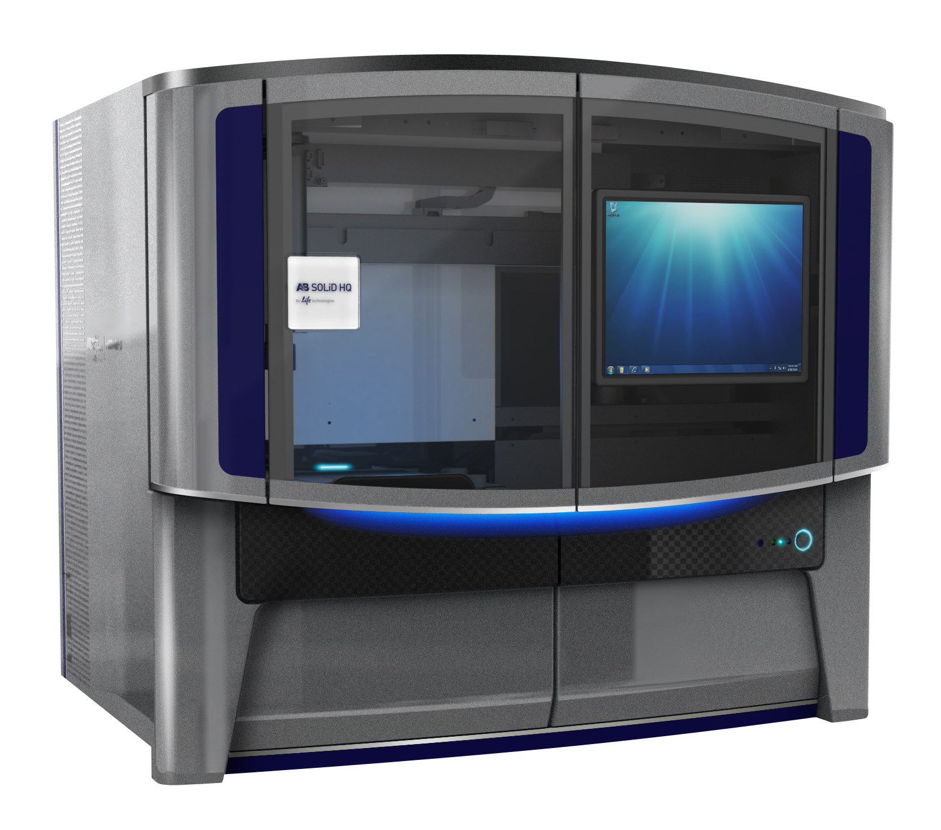
Life Technologies SOLiD
Instrument | Yield and run time | Read Length | Error rate | Error type
SOLiD 5500 wildfire | 600 GB, 8 days | 75x35 PE 60x60 MP | 0.01% | A-T Bias
Features
High accuracy due to two-base encoding
True paired-end chemistry - ligation from either end
Mate-pair libraries
Main applications (currently)
ChiPSeq

Slide 25
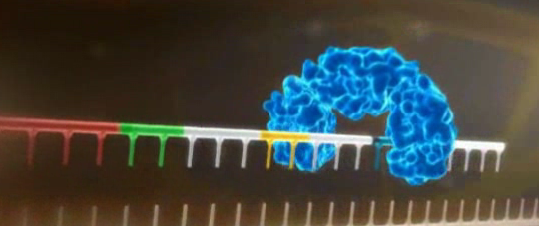
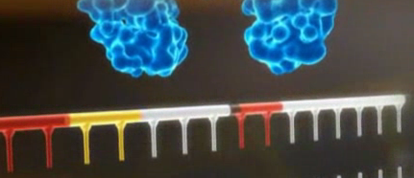
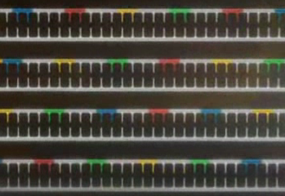
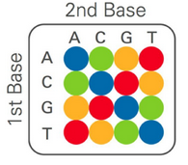
SOLiD - ligation

Slide 26
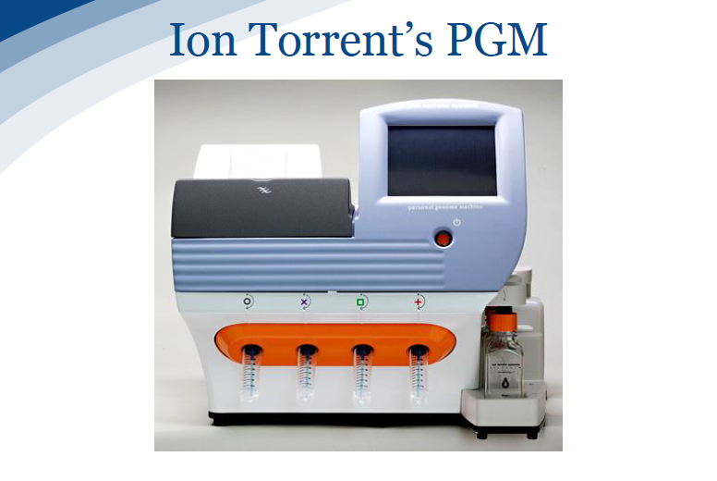
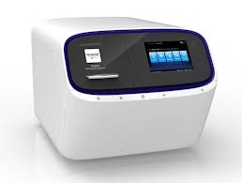
Life Technologies - Ion Torrent & Ion Proton
Chip | Yield - run time | Read Length
314, 316, 318 (PGM) | 0.1 – 1 Gb Gb, 3 hrs | 200 – 400 bp
P-I (Proton) | 10 Gb 4 hrs | 200 bp
520, 530, 540 (S5) | 1 Gb – 10 Gb 3 hrs | 400 bp
Main applications
Microbial and metagenomic sequencing
Targeted re-sequencing (gene panels)
Clinical sequencing

Slide 27
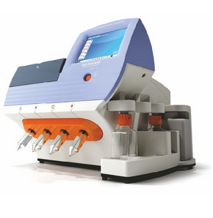
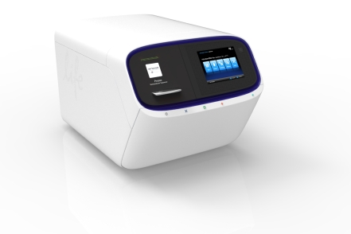
314 chip 316 chip 318 chip PI chip
10 Mb 100 Mb 1 Gb 10 Gb
200 – 400 bp
S5
200 bp
virus, bacteria, small eukaryote
eukaryote

Slide 28
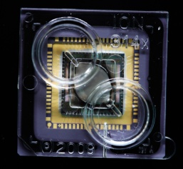
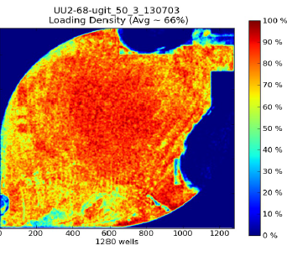
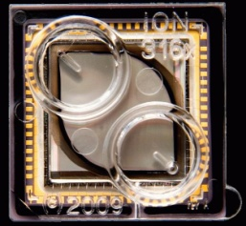
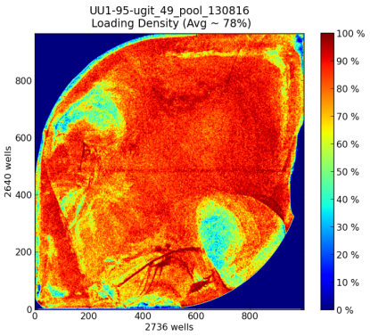
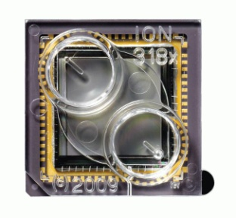
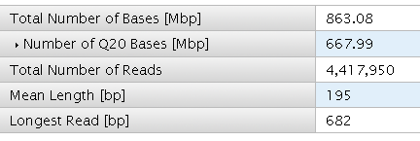
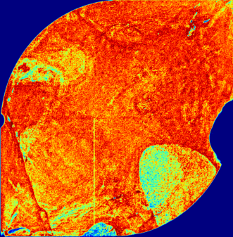
IonTorrent Throughput - 400bp
314 chip (10 Mbp)
316 chip (100 Mbp)
318 chip (1 Gbp)
Notes:
28

Slide 29
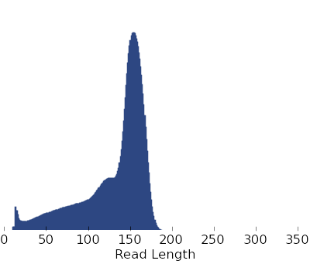
Ion Proton - Throughput
We now get 10-16GB data from the PI chip
> 90M reads
~ 150bp read length

Slide 30
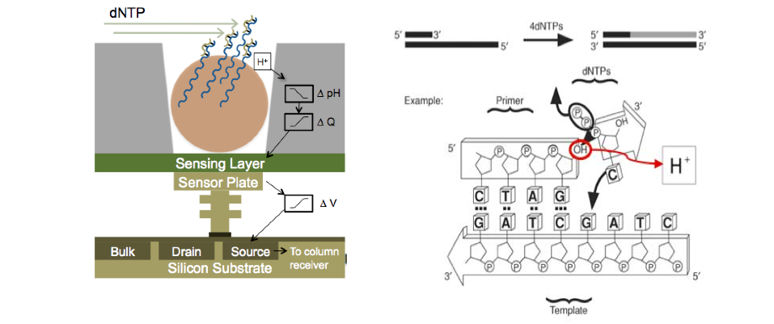
Ion Torrent - H⁺ ion-sensitive field effect transistors

Slide 31
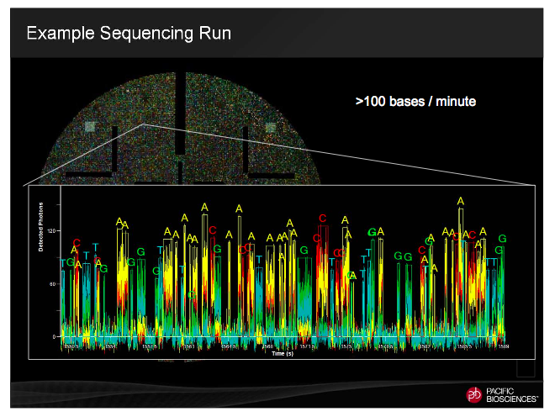
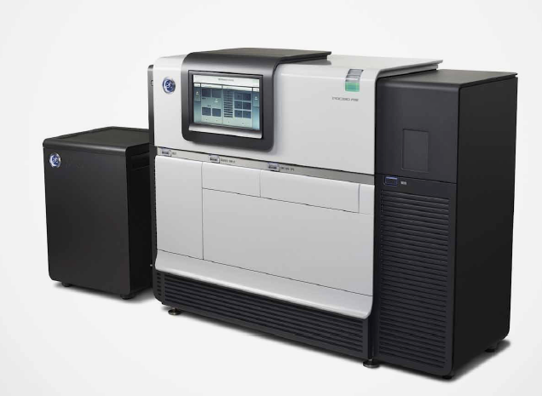
Pacific Bioscience
Instrument | Yield and run time | Read Length | Error rate | Error type
RS II | 500 Mb – 1.3 Gb /180 - 240 min SMRTCell | 250 bp – 20 000 bp (70 000 bp) | 15% (on a single passage!) | Insertions, random
Single-Molecule, Real-Time DNA sequencing

Slide 36
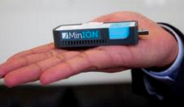
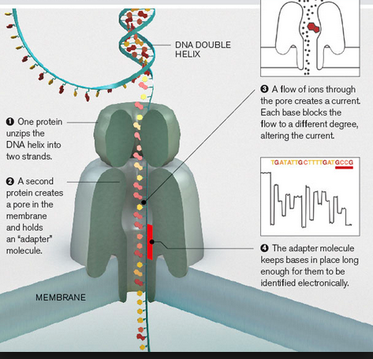
Oxford Nanopore MinION
Reads up to 100k
1D and 2D reads
15-40% error rate
Life time 5 days

Slide 37
 | Illumina HiSeq | Illumina MiSeq | Ion Torrent | Ion Proton | PacBio
Read length | 100 + 100 bp (150+150 bp) | 250 + 250 bp (350+350 bp) | 200 bp 400 bp (500 bp) | 150 bp 200 bp | 250 bp – 40 Kbp
WGS: - human - small | +++++ +++ | +++ | ++ | + ++ | (+++++) +++++
De novo | ++++ | ++ | ++ | ++ | +++++
RNA-seq miRNA | ++++ +++ |  |  | +++ +++ | +++*
ChIP | +++ |  |  | +++
Amplicon** | +++ | +++ | +++ | +++ | ++++
Methylation | +++ |  |  |  | ++++***
Target re-seq | ++ | +++ |  | +++ | (+++)
Exome | +++ |  |  | ++++ | (+)
+ Acceptable
++ OK
+++ Good
++++ Very good
+++++ Excellent
(…) It depends
* Only whole-length transcripts; ** Depends on amplicon size; *** Only prokaryotes

Slide 38
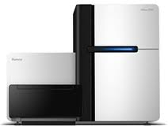
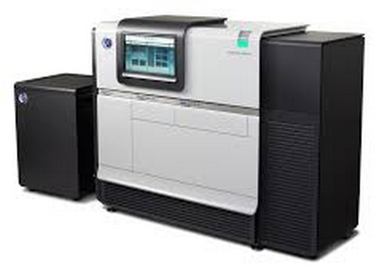
What is The BEST?

Slide 39
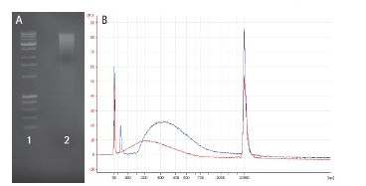
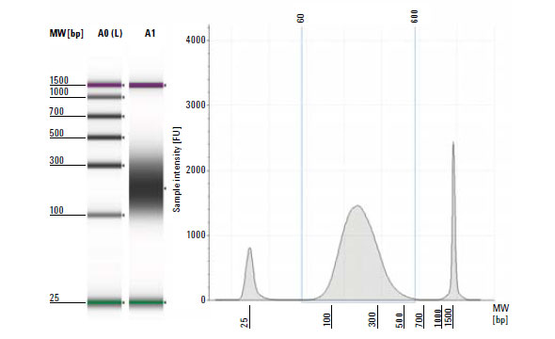
Making a NGS library
DNA QC – paramount importance
Sharing & size selection
Amplification
Ligation of sequencing adaptors, technology specific

Slide 40
Garbage in – garbage out: sequencing success to 90% depends on the sample quality

Slide 41
What do absorption ratios tell us?
Pure DNA 260/280: 1.8 – 2.0
< 1.8:
Too little DNA compared to other components of the solution; presence of organic contaminants: proteins and phenol; glycogen - absorb at 280 nm.
> 2.0:
High share of RNA.
Pure DNA 260/230: 2.0 – 2.2
<2.0:
Salt contamination, humic acids, peptides, aromatic compounds, polyphenols, urea, guanidine, thiocyanates (latter three are common kit components) – absorb at 230 nm.
>2.2:
High share of RNA, very high share of phenol, high turbidity, dirty instrument, wrong blank.
Photometrically active contaminants:
phenol, polyphenols, EDTA, thiocyanate, protein,
RNA, nucleotides (fragments below 5 bp)

Slide 42
How to make a correct measurement
Thaw DNA completely
Mix gently (never vortex!)
Put the sample on a thermoblock: 37°C, 15-30 min
Mix gently
Dilute 1:100 (if HMW)
Mix gently
Make a measurement with an appropriate blank
Low concentration
High concentration
DNA
solution

Slide 43
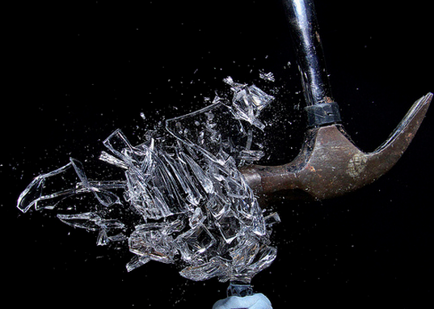
Sample prep: general recommendations
Treat DNA as a crystal vase: it is fragile when in solution
As soon as DNA is released from the cells – use wide-bore tips
Limit pipetting to minimum
Never vortex!
Do not heat above 65°C
Reduce amount of freeze-thaw cycles to minimum
Make several aliquotes of the stock DNA

Slide 44
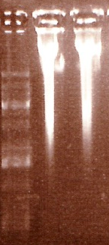
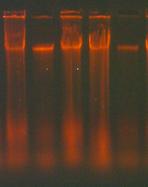
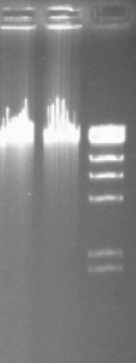
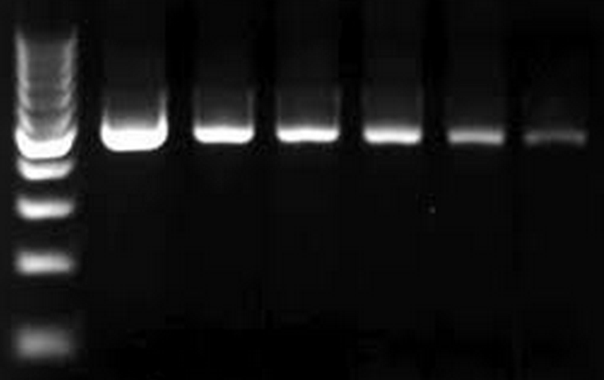
Post-extraction cleanup
Protein contamination
- Apply phenol-chloroform
RNA contamination
- Apply RNase, followed
by phenol-chloroform
extraction
Phenol carry-over or
overloaded sample?
If unsure, make dilution series.
If problem persists – try MoBio clean-up kit,
or re-extract DNA

Slide 45
Input QC control at NGI:
Qubit for DNA
Measures content of dsDNA only
Nanodrop & NanoVue overestimate concentrations up to 300%!
Bioanalyzer for RNA and amplicons
RNA: RIN values and concentrations
Amplicons: size distribution (extremely important!)

Slide 46
Bioanalyzer: amplicon size check
Example 1: OK size distribution
FOR ANY NGS TECHNOLOGY
Size difference among fragments must not
exceed 80 bp (optimally 50 bp)
Reason – preferential amplification of short fragments
Example 2: several sizes,
fractionation is needed
=> we HAVE to make several libraries
Example 3: broad peak;
size selection is needed

Slide 47
Sample prep: take home message
PCR-quality sample and
NGS-quality sample
are two completely different things

Slide 48
NGS technologies - SUMMARY
Platform | Read length | Accuracy | Projects / applications
454 | Medium | Homo- polymer runs | Microbial + targeted reseq
HiSeq MiSeq | Short Medium | High | Whole genome + transcriptome seq, exome
SOLiD | Short | High | Whole genome + transcriptome seq, exome
Ion Torrent | Medium | High | Microbial + targeted reseq
Ion Proton | Short/Medium | High | Exome, transcriptome, genome
PacBio | Long | Low – ultra high* | Microbial + targeted reseq Gap closure & scaffolding
MinION | Long | Low | Gap closure, scaffolding structural variants

Slide 49
Check list:
Have others done similar work?
Is your methodology sound? Sample size? Repetitions?
Is there people to analyze the data?
Is there computer capacity to analyze the data?
Will you be able to publish NGS data by yourself?
PLEASE consult the sequencing facility & BILS
PRIOR to onset of your project!

Slide 50
Common pitfalls and a piece of advise:
If you give us low quality DNA/RNA - expect low quality data
If you give us too little DNA/RNA – expect biased data
Do not try to do everything by yourself
Make sure there is a dedicated bioinformatician available
Never underestimate time and money needed for data analysis
Google often!
Use online forums, e.g. SeqAnswers.com

Slide 51
Summary
Progress is FAST- keep yourselves updated!
Chose technology based on:
What is most feasible
What is most accessible
What is most cost-effective
SciLifeLab Genomics & Bioinformatics are here for you!

Slide 54
National Genomics Infrastructure
SciLifeLab, Stockholm
SciLifeLab, Uppsala
Mid 2010
Uppmax, Uppsala

Slide 55
Projects at CMS
3. Access to genomics platform
Portal project flow
NGI Project coordinators meet every second day via Skype
Ulrika Liljedahl
SNP&SEQ
Uppsala node
Mattias Ormestad
Stockholm Node
Olga Vinnere Pettersson
UGC
Uppsala Node
Project distribution is based on:
Wish of PI
Type of sequencing technology
Type of application
Queue at technology platforms
Project is then assigned to a certain node and a coordinator contacts the PI

Slide 56
NGI Equipment
Illumina HiSeq 2000/2500 17
Illumina MiSeq 3
Illumina X 10
Life Technologies SOLiD 5500wildfire 1
Life Technologies Ion Torrent 2
Life Technologies Ion Proton 6
Life Technologies Sanger ABI3730 2
Pacific Biosciences RSII 2
Argus Whole Genome Mapping System 1
One of 5 best-equipped NGS sites in Europe

Slide 57
Projects at CMS
3. Access to genomics platform
Project meeting
What we can help you with:
Design your experiment based on the scientific question.
Chose the best suited application for your project.
Find the most optimal sequencing setup.
Answer all questions about our technologies and applications, as well as bioinformatics.
In special cases, we can give extra-support with bioinformatics analysis – development of novel methods and applications

Slide 58
Downstream Data Analysis
Bioinformatics competence IS NOT present in research group
Bioinformatics competence IS present in research group
Cooperation with platform personnel: R&D
BILS:
Bioinformatics Infrastructure
for Life
Sciences
WABI:
Wallenberg
Advanced
Bioinformatics
Initiative
Co-authorship
Short-term commitment
Long-term commitment

