Slide 1
NBIS The national bioinformatics infrastructure Sweden www.scilifelab.se/platforms/bioinformatics/
Malin Larsson, malin.larsson@scilifelab.se

Slide 2
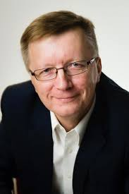
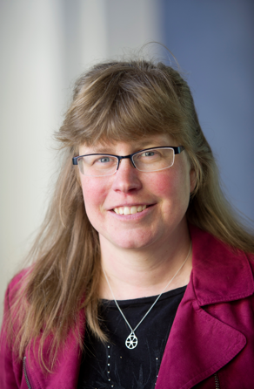
SciLifeLab
SciLifeLab
National service
Local scientific center
Director (July 2015)
Olli Kallioniemi
Co-director
Kerstin Lindblad-Toh
Vision:
To be an internationally leading center that develops, uses and provides access to advanced technologies for molecular biosciences with focus on health and environment.
2010: Strategic research initiative
2013: National resource
www.scilifelab.se

Slide 3
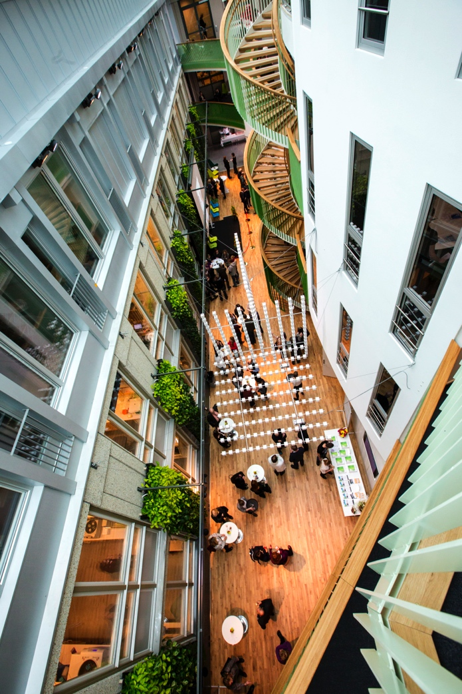
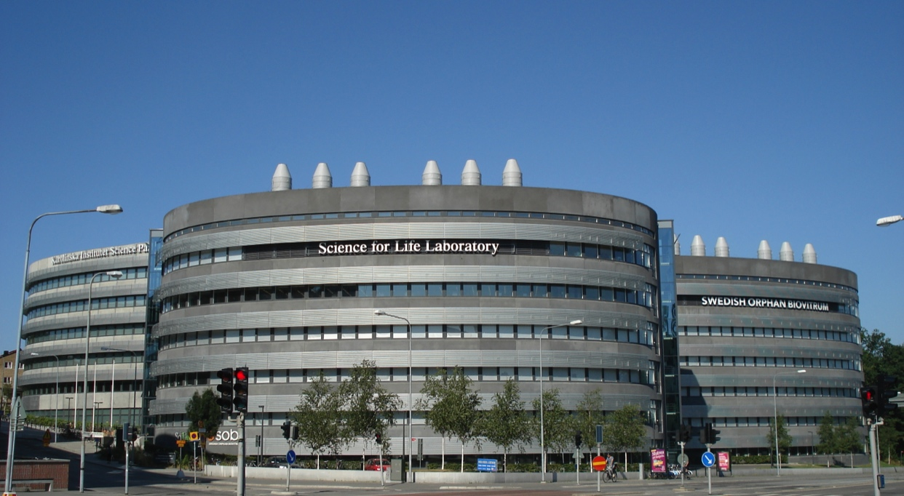
Main sites (Stockholm/Uppsala)
Stockholm (KI campus)
9 national service platforms
200+ research groups
Uppsala (Biomedical center)

Slide 4
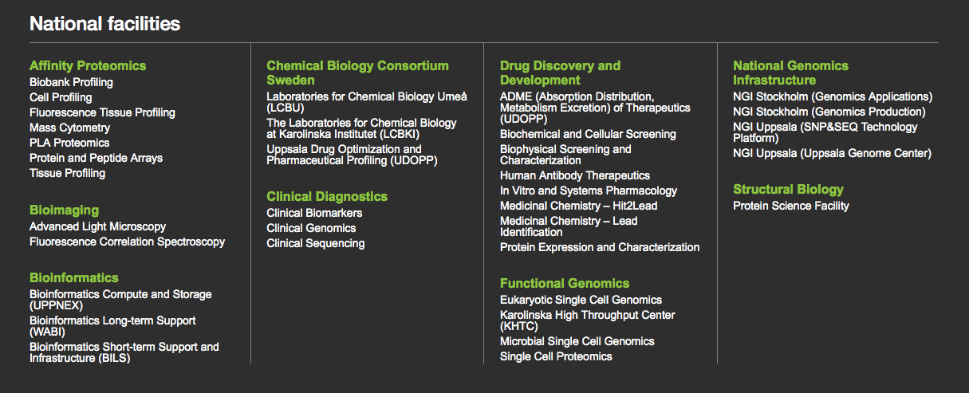
SciLifeLab provides state-of-the art services
NGI (One of the largest sequencing centers in Europe) X-Ten, HiSeq, MiSeq, PacBio, IonTorrent, MinIon, Optical mapping
Clinical Diagnostics Sequencing and other omics for new clinical applications
Bioinformatics Approaching 100 FTE for custom-tailored project support, methods and systems development, data publishing
Functional Genomics Single-cell transcriptomics, genomics, and proteomics
…

Slide 5
The national bioinformatics infrastructure Sweden (NBIS) constitutes the Bioinformatics platform at SciLifeLab
NBIS will be official as of 2016. Most of the activities are already fully operational, and NBIS is the continuation and expansion of present activities, unifying all national bioinformatics support into a single infrastructure.

Slide 6
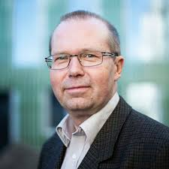
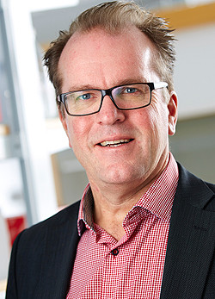
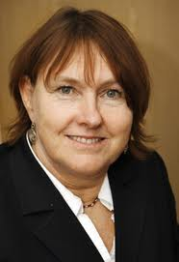
SciLifeLab platforms
SciLifeLab
VR
National Genomics Infrastructure
National Bioinformatics Infrastructure
Sweden
Clinical Diagnostics
…
SNIC
Joakim Lundeberg Ann-Christine Syvänen
Ulf Gyllensten
Bengt Persson
Lars Engstrand
Computer resources free for Swedish researchers
Ongoing merge of BILS, WABI and more; complete 2016.
National, distributed

Slide 7
BIOINFORMATICS PLATFORM
Data producing platforms
(eg sequencing)
Development
Lab Bioinfo
Project support and tools development
Data
Supercomputer center
Platform
accounts
Customer project accounts
DELIVERY
PREDEFINED ANALYSES
CUSTOM-TAILORED ANALYSES

Slide 8
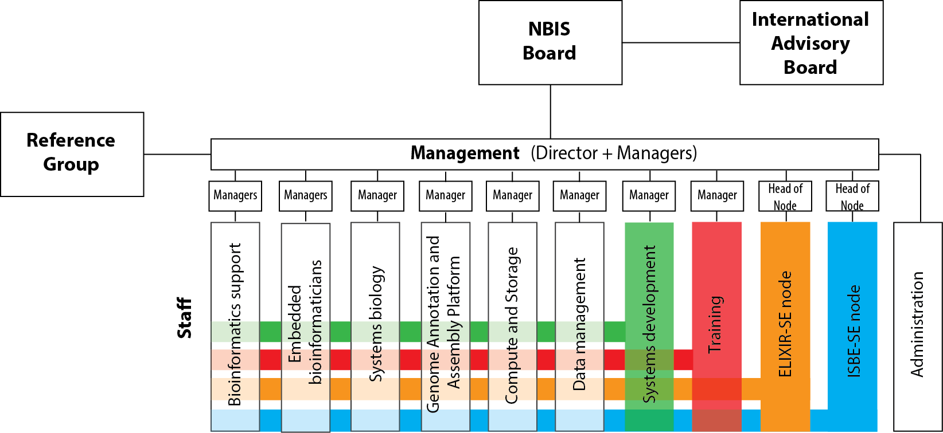
The Bioinformatics Platform 2016
Funding
The Research Council
SciLifeLab
KAW foundation
Host universities
Recently applied at the Research Council as continued national infrastructure 2016-2023. Decision late 2015.
Custom-tailored support
Tools
Training

Slide 9
Why bioinformatics infrastructure?
A continuous technical scale‐up will provide an unprecedented amount of heterogeneous omics data
- Support, Tools, Training
System‐level analyses in biomedical research will transform life science
- Strategic positioning in systems biology
Large‐scale omics is will make a major leap into translational research and diagnostics
- Method adaptation and expert advice

Slide 10
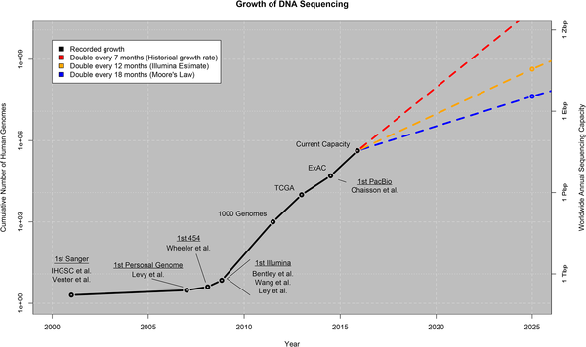
Fig 1. Growth of DNA sequencing.
Stephens ZD, Lee SY, Faghri F, Campbell RH, Zhai C, et al. (2015) Big Data: Astronomical or Genomical?. PLoS Biol 13(7): e1002195. doi:10.1371/journal.pbio.1002195
http://127.0.0.1:8081/plosbiology/article?id=info:doi/10.1371/journal.pbio.1002195

Slide 11
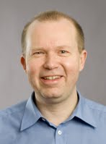
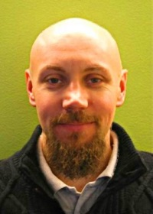
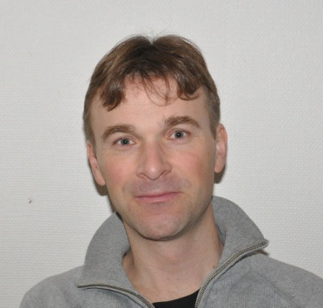
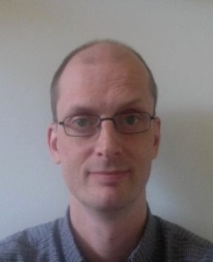
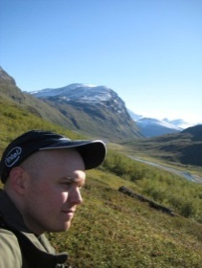
Short-term Support and Infrastructure BILS – Bioinformatics Infrastructure for Life Sciences
www.scilifelab.se/facilities/bils/
Technical Proteomics Director coordinator coordinator
BILS is a distributed national research infrastructure supported by the Swedish Research Council (VR)
BILS provides
Support/Consultancy
40 hours for free
additional hours for a subsidised fee (3000 SEK/day)
Training
Infrastructure/tools
BILS coordinates the Swedish node in the European infrastructure for biological information ELIXIR
Bengt Mikael Fredrik Persson Borg Levander
Syst. development Training
Genomics coordinators coordinator coordinator
Magnus Henrik Dag Jonas Sara
Alm-Rosenblad Lantz Ahrén Hagberg Light

Slide 12
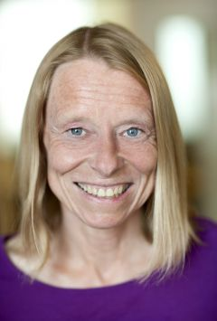
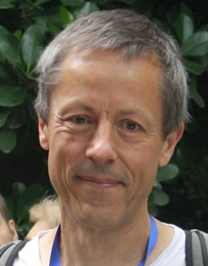
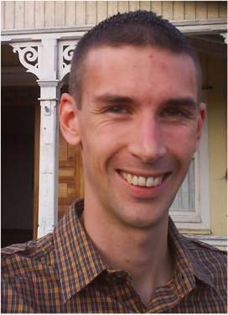
Long-term Support
Wallenberg Advanced Bioinformatics Infrastructure
www.scilifelab.se/facilities/wabi/
Tailored solutions – high impact
Applied bioinformatics: 500h free support/project
Variant analyses in health and disease
Transcriptomics
Novel genomes
Metagenomics
Directors
Swedens strongest unit for analyses of large-scale genomic data (13 + 10 FTE)
Siv Andersson
Gunnar von Heijne
Managers
National committee reviews and selects projects based on scientific quality
Ongoing expansion with staff in Lund, Gothenburg, Linköping and Umeå.
Björn Nystedt
Thomas Svensson

Slide 13
The bioinformatics platform
A centralized computer resource for the entire country, with 250+ life science software!
(Organized through SNIC)
20 projects/year
Long-term
500 h / project
Short- and mid-term
80 h / project
400 projects/year
System design/ development/allocation
600 projects/year
Compute
Number of projects
Support hours per project

Slide 14
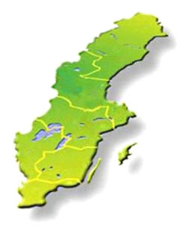
User access to the Bioinformatics Platform
Compute and storage (free; majority of hardware and system administration belongs to SNIC) http://www.uppmax.uu.se/
Study design consultation (free) support@bils.se
Short-term support (≤80h; free; first come first serve)
Medium-term support (>80h; user fee; first come first serve) http://bils.se/resources/supportform/index.php
Long-term support (500h; free: scientific evaluation) http://www.scilifelab.se/facilities/wabi/

Slide 15
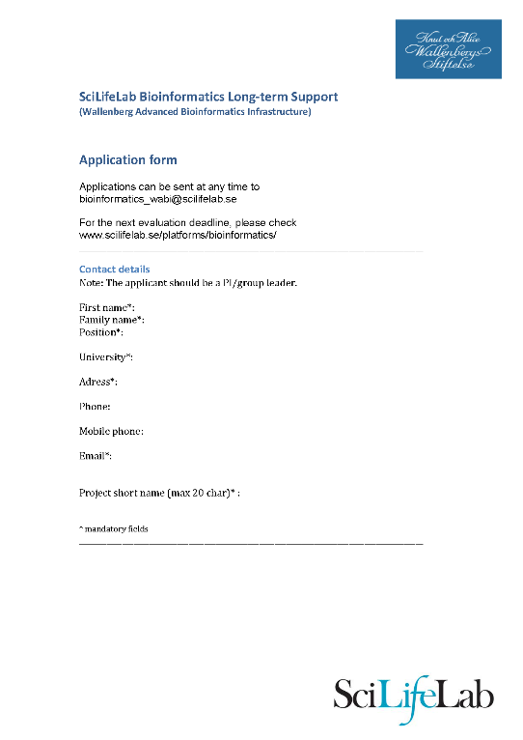
How to get bioinformatics support?
Long term support
3-4 application rounds per year. Next deadline: January?
Short term support
Use support form at bils.se
Apply anytime!
https://bils.se
http://www.scilifelab.se/facilities/wabi/

Slide 16
Expert teams
Assembly/annotation of novel genomes
support@bils.se
(2 + 2 people, running)
Human WGS ToolBox
Method implementation, community building
https://wabi-wiki.scilifelab.se/display/SHGATG/
(2+ people, running)
BigData/Integrative bioinformatics
Method development, project support
http://www.scilifelab.se/facilities/wabi/
(4 people, hiring now, part of Long-term Support)

Slide 17
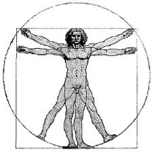
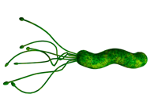
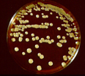
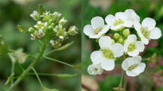
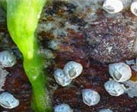
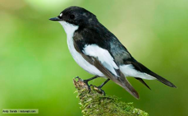
“Routinely unique” Difficult to forsee/automate
7 Variant analyses in medical research Human
4 Differential gene expression
3 single-cell RNAseq
2 Epigenetics
1 miRNA
1 Allele-specific expresssion + methylSeq
1 Immunorepertoire
1 Integrative
20
5 Variant calling/Population genomics Animals/plants
4 De novo genome assembly/analyses Animals/plants
3 Gene expression Animals/Plants
2 RNAseq method development Universal
1 RNAseq + proteomics Fungus
1 Metagenomics Human microbiota
1 Non-coding RNA Bacteria
17

Slide 18
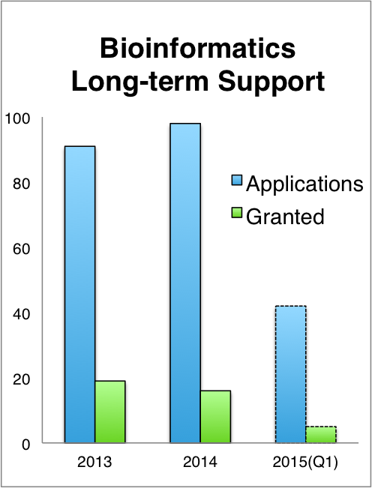
Happy users, high demand
User evaluation April 2015

Slide 19
Scientific highlights 2014/2015
Methods
Boekel J, Chilton JM, Cooke IR, Horvatovich PL, Jagtap PD, Kall L, Lehtio J, Lukasse P, Moerland PD, Griffin TJ (2015) Multi-omic data analysis using Galaxy. Nat. Biotechnol., 33:137–139.
Branca RM, Orre LM, Johansson HJ, Granholm V, Huss M, Perez-Bercoff A., Forshed J, Kall L, Lehtio J (2014) HiRIEF LC-MS enables deep proteome coverage and unbiased proteogenomics. Nat. Methods, 11, 59–62.
Alneberg J, Bjarnason BS, de Bruijn I, Schirmer M, Quick J, Ijaz UZ, Lahti L, Loman NJ, Andersson AF, Quince C (2014) Binning metagenomic contigs by coverage and composition. Nat. Methods, 11:1144–1146.
Evolution and biodiversity
Poelstra JW, Vijay N, Bossu CM, Lantz H, Ryll B, Muller I, Baglione V, Unneberg P, Wikelski M, Grabherr MG, Wolf JB (2014) The genomic landscape underlying phenotypic integrity in the face of gene flow in crows. Science, 344:1410-1414
Martinez Barrio A*, Lamichhaney S*, Fan G*, Pettersson M, Rafati N, Zhang H, Dainat J, Ekman D, Höppner D, Jern P, Martin M, Nystedt B, Liu X, Chen W, Liang X, Shi C, Fu Y, Ma K, Zhan X, Feng C, Gustafson U, Rubin C-J, Blass M, Casini M, Folkvord A,Laikre L, Ryman N, Ming-Yuen Lee S, Xu X, Andersson L (2015) The Atlantic herring genome – the genetic architecture underlying ecological adaptation (Nature, in review)
Steige KA, Reimegård J, Koenig D, Scofield DG, Slotte T (2015) Analysis of allele-specific expression reveals cis-regulatory changes associated with a recent mating system shift and floral adaptation in Capsella (2015) (Mol. Biol. Evo., submitted)
Medical research
Alkasalias T, Flaberg E, Kashuba V, Alexeyenko A, Pavlova T, Savchenko A, Szekely L, Klein G, Guven H (2014) Inhibition of tumor cell proliferation and motility by fibroblasts is both contact and soluble factor dependent. Proc. Natl. Acad. Sci. U.S.A., 111:17188–17193.
Lindqvist CM, Nordlund J, Ekman D, Johansson A, Moghadam BT, Raine A, Overnäs E, Dahlberg J, Wahlberg P, Henriksson N, Abrahamsson J, Frost BM, Grandér D, Heyman M, Larsson R, Palle J, Söderhäll S, Forestier E, Lönnerholm G, Syvänen AC, Berglund EC (2015) The Mutational Landscape in Pediatric Acute Lymphoblastic Leukemia Deciphered by Whole Genome Sequencing. Human Mutation 36:118–128
Einarsdottir B, Bagge RO, Bhadury J, Jespersen H, Mattsson J, Nilsson L, Truvé K, López MD, Naredi P, Nilsson O, Stierner U, Ny L, Nilsson J (2014). Melanoma patient-derived xenografts accurately model the disease and develop fast enough to guide treatment decisions. Oncotarget, 5:9609–9618.
Lindholm ME, Huss M, Solnestam BW, Kjellqvist S, Lundeberg J, Sundberg CJ (2014) The human skeletal muscle transcriptome: sex differences, alternative splicing, and tissue homogeneity assessed with RNA sequencing. FASEB J. 28:4571-4581
Browall S, Norman M, Tångrot J, Galanis I, Sjöström K, Dagerhamn J, Hellberg C, Pathak A, Spadafina T, Sandgren A, Bättig P, Franzén O, Andersson B, Örtqvist Å, Normark S, Henriques-Normark B (2014) Intraclonal Variations Among Streptococcus pneumoniae Isolates Influence the Likelihood of Invasive Disease in Children. Journal of Infectious Diseases, 209: 377–388.

Slide 20
SciLifeLab Bioinformatics Courses
Course | Date | Participants | Evaluation score (max 5)
Introduction to bioinformatics using NGS data | April 2013 | 24 | 4.6
 | Nov 2013 | 24 | 4.3
 | March 2014 | 24 | 4.5
 | April 2014 | 24 | 3.8
 | Sept 2014 | 24 | 4.1
 | Nov 2014 | 24 | 4.3
Perl programming for biological sciences | May 2013 | 20 | 4.4
 | Oct 2013 | 20 | 4.4
 | May 2014 | 20 | 4.7
 | Oct 2014 | 20 | 4.5
Genome Assembly | Nov 2013 | 20 | 4.1
 | Nov 2014 | 20 | 4.4
Human Genetic Variation | June 2013 | 15 | 4.5
 | Sept 2013 | 20 | 3.9
RNAseq | June 2013 | 15 | 4.1
 | Sept 2013 | 20 | 4.2
 | Oct 2014 | 20 | 4.3
RNAseq and proteomics | June 2014 | 20 | 4.1
Metagenomics | Nov 2014 | 20 | 4.2
TOTAL 2013 + 2014 |  | 394 | 4.3
www.scilifelab.se/education/courses/

Slide 21
The Swedish Bioinformatics Advisory Program
A new teaching model, where PhD students get a senior bioinformatician as a personal advisor during 2 years of their PhD.
Monthly project meetings + two grand meetings per year to aid networking and knowledge transfer.
First call late 2014:
>50 applicants for 15 places
www.scilifelab.se/education/mentorship/the-swedish-bioinformatics-advisory-program/
Second call out, deadline Nov 19 2015!

Slide 22
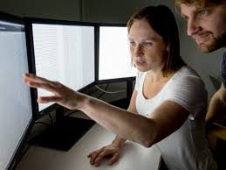
Why this program
Overall aim: Great research in Sweden!
How? Strategic investment in PhD education Complementing PhD supervisors with technical expertise
Catalyze transition to large-scale data analyses
The PhD student is responsible to prepare and drive the meetings!

Slide 23
Bioinformatics Drop-In Lund
Are you planning a project and need someone to discuss the bioinformatics analysis with?
Do you need bioinformatics support, but do not know who to turn to?
Are you stuck in your own bioinformatics project and need help?
Meet the NBIS staff in Lund at bioinformatics drop-in
When: Weekly on Wednesdays at 10 am
Where: Medicon village / Biologiska institutionen Location will be evaluated after the initial meetings.

Slide 24
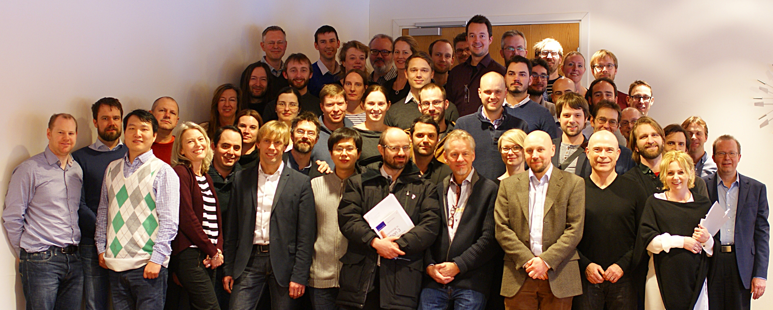
We’re here for you!

