Slide 1
Next Generation Sequencing – An Overview
Olga Vinnere Pettersson, PhD
National Genomics Infrastructure hosted by ScilifeLab,
Uppsala Node (UGC)
Version 6.3

Slide 2
Outline:
www.robustpm.com
A bit of history
NGS technologies & sample prep
NGS applications
National Genomics Infrastructure – Sweden

Slide 3
HISTORY

Slide 4
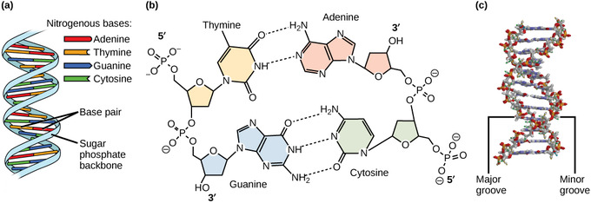
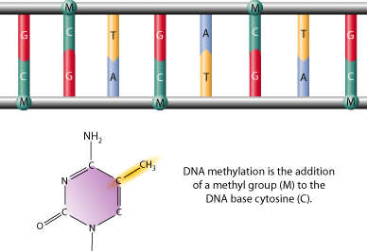
What is sequencing?
https://figures.boundless-cdn.com

Slide 5
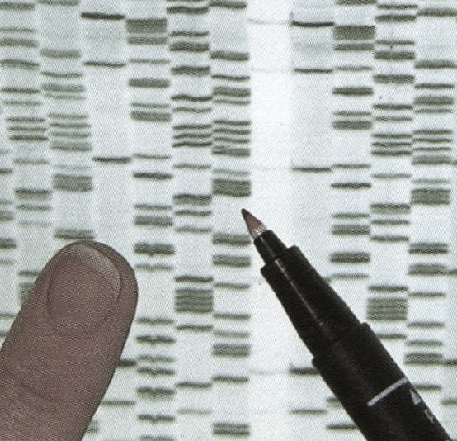
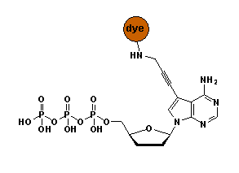
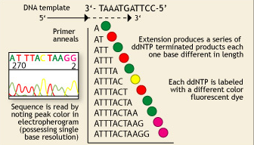
Once upon a time…
Fredrik Sanger and Alan Coulson
Chain Termination Sequencing (1977)
Nobel prize 1980
Principle:
SYNTHESIS of DNA is randomly TERMINATED at different points
Separation of fragments that are 1 nucleotide different in size
!
Lack of OH-group at 3’ position of deoxyribose
1 molecule sequenced at a time = 1 read
Capillary sequencer: 384 reads per run

Slide 6
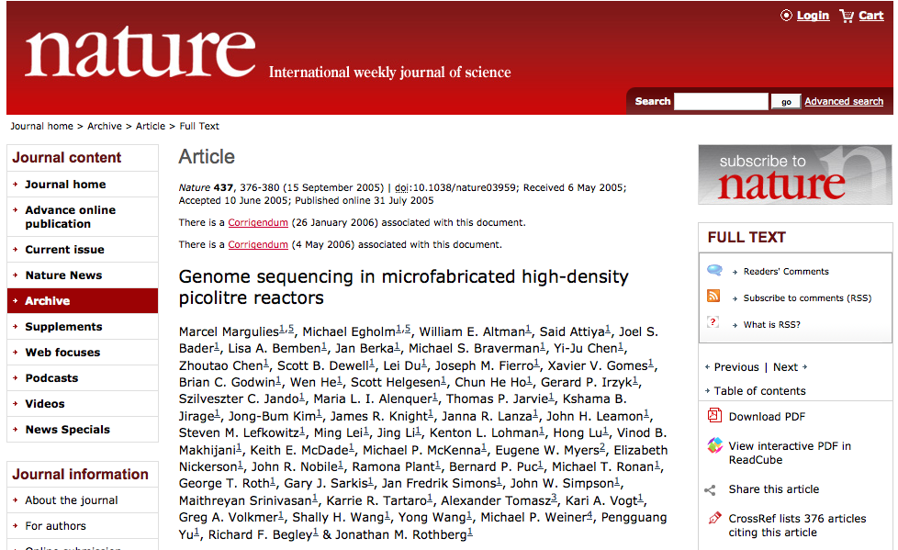
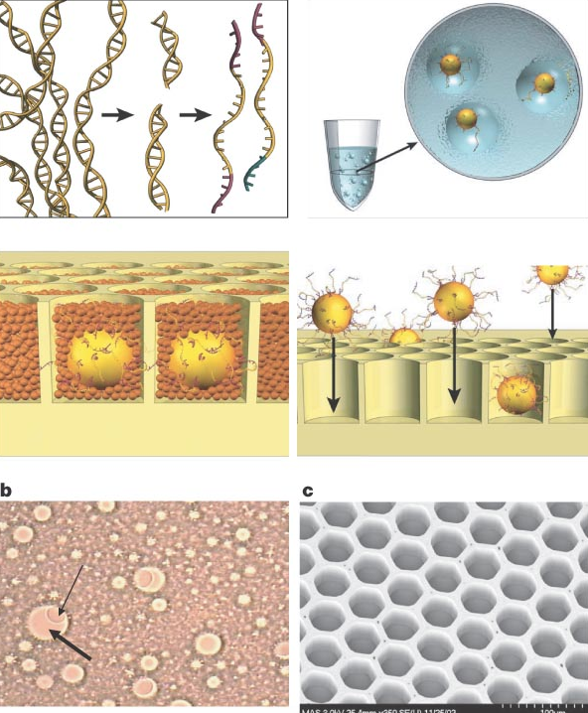
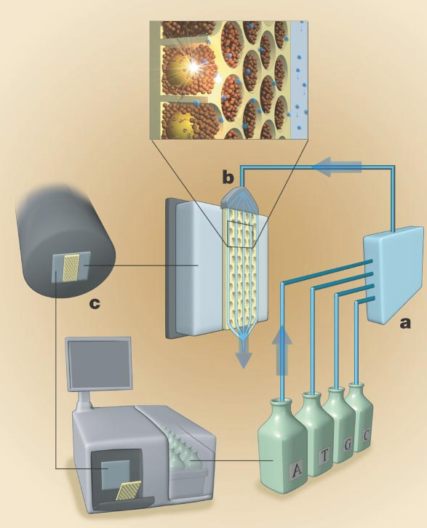
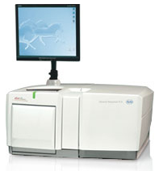
2006 REVOLUTION
Thousands of molecules sequenced in parallel
1 mln reads sequenced per run
Roche 454 GS FLX

Slide 7
Technologies

Slide 8
NGS technologies
Company | Platform | Amplification | Sequencing method
Roche | 454 (until 2016) | emPCR | Pyrosequencing
Illumina | HiSeq, MiSeq NextSeq, X10 | Bridge PCR | Synthesis
LifeTechnologies(Thermo Fisher) | Ion Torrent, Ion Proton, S5 | emPCR | Synthesis (pH)
Pacific Biosciences | RSII SEQUEL | None | Synthesis (SMRT)
Complete genomics | Nanoballs | None | Ligation
Oxford Nanopore* | MinION GridION | None | Flow
RIP technologies: Helicos, Polonator, SOLiD, 454 etc.
In development: Tunneling currents, nanopores, etc.

Slide 9
Differences between platforms
Technology: chemistry + signal detection
Run times vary from hours to days
Production range from Mb to Gb
Read length from <100 bp to > 20 Kbp
Accuracy per base from 0.1% to 15%
Cost per base

Slide 10
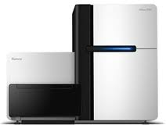
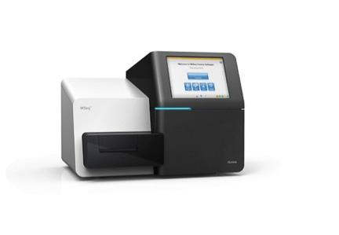
Illumina
Instrument | Yield and run time | Read Length | Error rate | Error type
HiSeq2500 | 120 Gb – 600 Gb 27h or standard run | 100x100 (250x250) | 0.1% | Subst
MiSeq | 540 Mb – 15 Gb (4 – 48 hours) | Up to 350x350 | 0.1% | Subst
HiSeqXten | 800 Gb - 1.8 Tb (3 days) | 150x150 | “ | “
Main applications
Whole genome, exome and targeted reseq
Transcriptome analyses
Methylome and ChiPSeq
Rapid targeted resequencing (MiSeq)
Human genome seq (Xten)

Slide 11
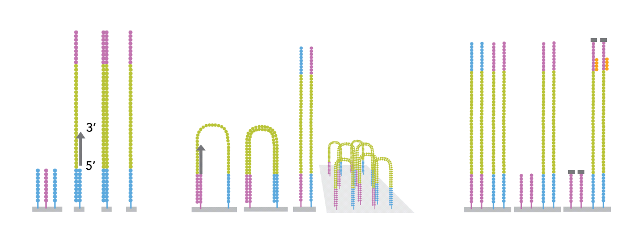
Illumina: bridge amplification
200M fragments per lane
Bridge amplification
Ends with blocking of free 3’-ends and
hybridisation of sequencing primer
Notes:
De fragment som ska sekvensera amplifiera I flödescellen för att möjliggöra detektion av signalerna från sekvensningen. Detta sker I en så kallad klulstergenerering, där de fragment som ska sekvenseras kopieras ca 1000x på en liten delyta och varje fragment då bildar ett sk klluster.
Förenklad bild, sker samtidigt för ca 200M fragment per lane I flödescellen.
Adaptern på sekvensningsbiblioteken binder till komplementära sekvenser på ytan I flödescellen. Den komplementära sekvensen fungerar

Slide 12
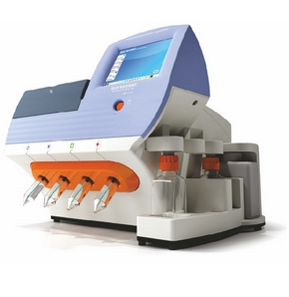
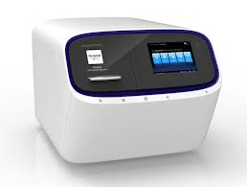
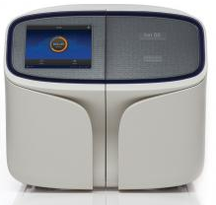
Ion Torrent
Chip | Yield - run time | Read Length
314, 316, 318 (PGM) | 0.1 – 1 Gb Gb, 3 hrs | 200 – 400 bp
P-I (Proton) | 10 Gb 4 hrs | 200 bp
520, 530, 540 (S5) | 1 Gb – 10 Gb 3 hrs | 400 (600) bp (except 540)
Main applications
Microbial and metagenomic sequencing
Targeted re-sequencing (gene panels)
Clinical sequencing

Slide 13
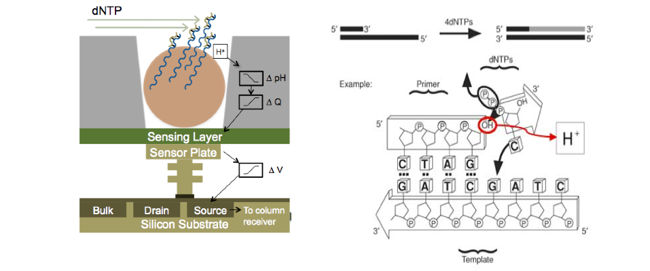
Ion Torrent - H⁺ ion-sensitive field effect transistors

Slide 14
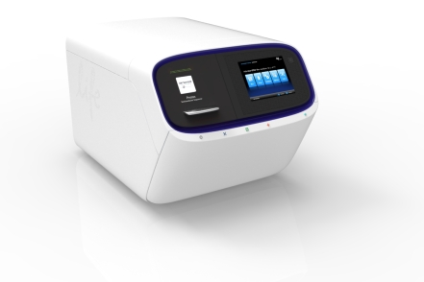
Ion PGM
Ion S5XL
314 316 318
520 530 540
250 000 4 mln 9 mln
400 bp 400 bp 400 bp
100 Mb 500 Mb 1 Gb
8 mln 15-20 mln 90 mln
400 bp 400 bp 200 bp
1 Gb 5 Gb 10 Gb
Ion Proton
PI
90 mln
200 bp
10-18 Gb

Slide 15
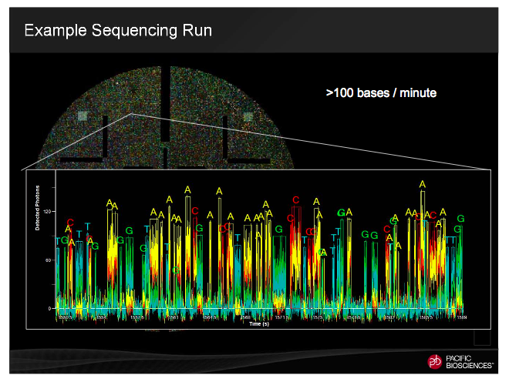
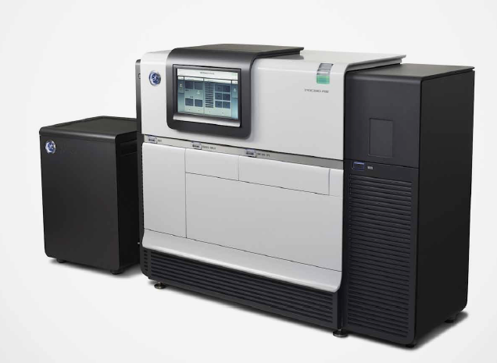
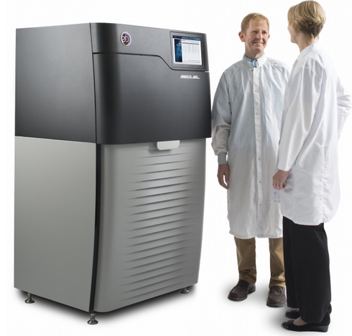
PacBio SMRT-technology
Instrument | Yield and run time | Read Length | Error rate | Error type
RS II Sequel (R&D) | 250 Mb – 1.3 Gb /30 - 360 min SMRTCell | 250 bp – 30 000 bp (70 000 bp) | 15% (on a single passage!) | Insertions, random
Single-Molecule, Real-Time DNA sequencing

Slide 16
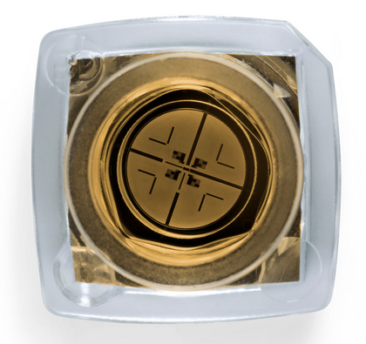
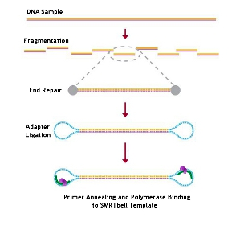
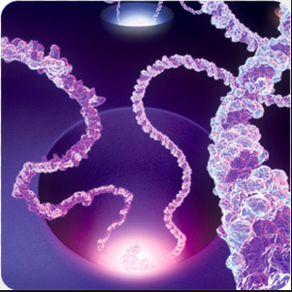
PacBio SMRT - technology
Single Molecule Real Time

Slide 18
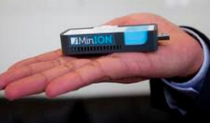
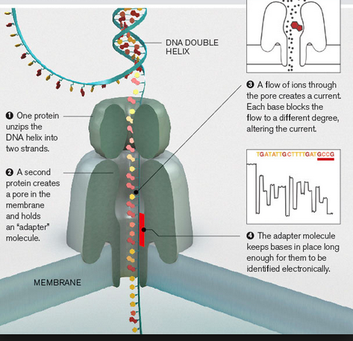
Oxford Nanopore MinION
Reads up to 100k
1D and 2D reads
15-40% error rate
Life time 5 days

Slide 19
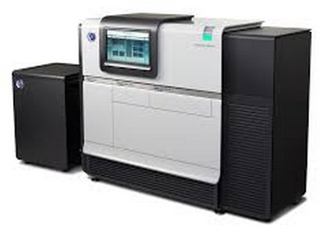
Main types of equipment
PacBio RSII
Ultra-long reads
FAST throughput
Illumina HiSeq
Illumina Xten
Illumina MiSeq
Short paired reads
HIGH throughput
Ion Torrent PGM
Ion Proton
Ion S5 XL
Short single-end reads
FAST throughput

Slide 20
Applications

Slide 21
NGS/MPS applications
Whole genome sequencing:
De novo sequencing
Re-sequencing
Transcriptome sequencing:
mRNA-seq
miRNA
Isoform discovery
Target re-sequencing
Exome
Large portions of a genome
Gene panels
Amplicons

Slide 22
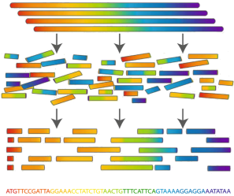
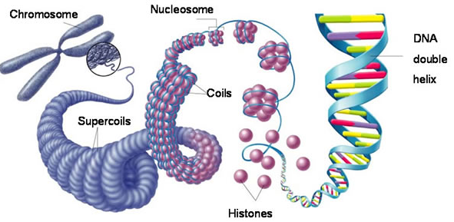
De novo sequencing
Used to create a reference genome without previous reference

Slide 23
De novo sequencing:
Illumina strategy
Sequencing:
PE library with 350 bp
PE library with 600 bp
MP library with 2 kb
MP library with 5-8-20 kb
PE: 50-100x, MP 10-15x
Analysis:
ALLPATH
PacBio strategy
Sequencing:
10-20 kb library
50-80x
(where 30x are reads above 10 kb)
Analysis:
HGAP (haploid)
FALCON (diploid)

Slide 24
De novo sequencing:
Illumina strategy
PacBio strategy
Prokaryotes: €€€ €
Eukaryotes up to 250 Mb €€ €€
Eukaryotes over 500 Mb €€€€ €€€€€€

Slide 25
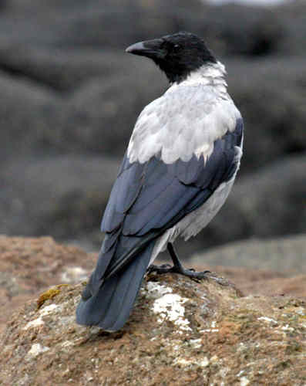
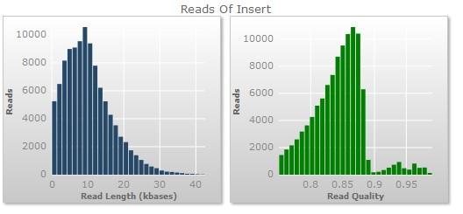
Example: de novo PacBio; Crow
Sequencing results
Number of SMRT cells: 70
Total bases per SMRT: 1.39 Gb
Total reads per SMRT: 106 833
Assembly results, FALCON
PRIMARY ALTERNATIVE
N50 8.5 Mb 23 kb
N75 3.9 Mb 18 kb
Nr contigs 4375 2614
Longest contig 36 Mb 121 kb
Total length 1.09 Gb 45 Mb
Notes:
BCR/ABL
HepC

Slide 26
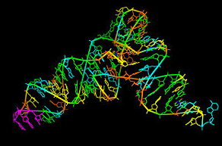
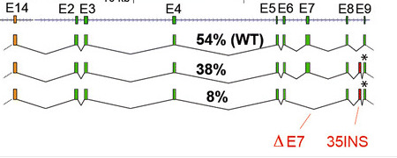
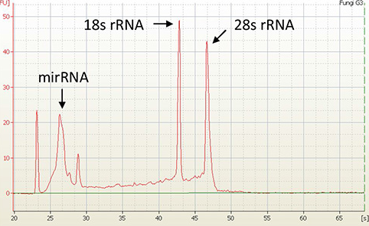
Transcriptome sequencing (RNA-seq)
TOTAL RNA
mRNA
Dif.ex.
Annotation
Splice isoforms
Non-codingRNA
miRNA
Transcriptional regulation

Slide 27
mRNA: rRNA depletion vs polyA selection
Method | Pros | Cons | Recommended
rRNA depletion | Captures on-going transcription Picks up non-coding RNA | Does not get rid of all rRNA Messy Dif.Ex. profile | 20-40 mln reads (single or PE)
polyA selection | Gives a clean Dif.Ex. profile | Does not pick non-coding RNA | 5-20 mln reads
Alternative for human RNA-seq:
AmpliSeq Human Transcriptome panel:
faster, cheaper, works fine with FFPE
input: 50 ng total RNA
dif.ex. ONLY

Slide 28
RNA-seq experimental setup
mRNA only: any kit
mRNA and miRNA: only specialized kits
Always use DNase!
RIN value above 8.
CONTROL vs experimental conditions
Biological replicates: 4 strongly recommended

Slide 29
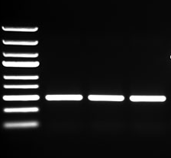
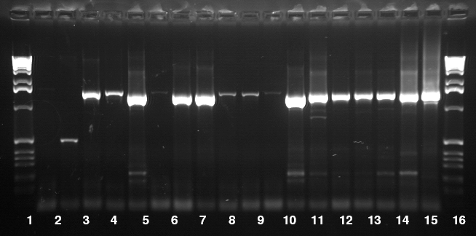
Amplicon sequencing
Used a lot in metagenomics
Community analysis
rRNA genes & spacers (16S, ITS)
Functional genes
Genotyping by sequencing

Slide 30
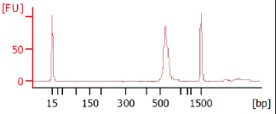
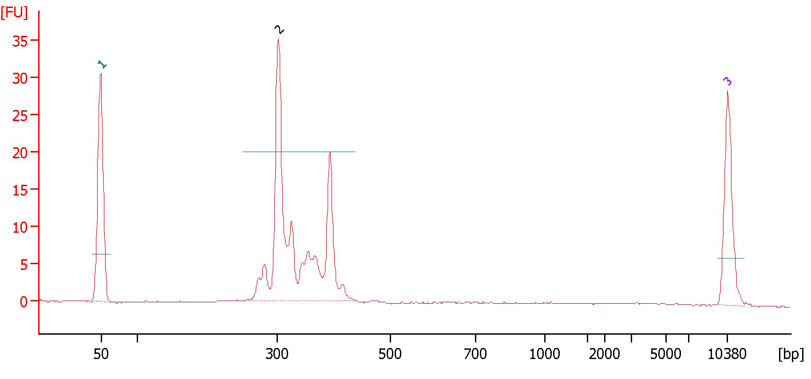
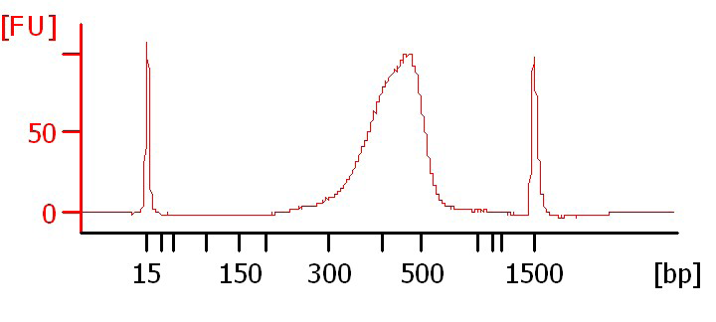
Amplicon sequencing
Example 1: tight peak, OK
FOR ANY NGS TECHNOLOGY
Size difference among fragments must not
exceed 80 bp (or 20% in length)
Reason – preferential amplification of short fragments
Example 2: several sizes,
fractionation is needed
=> we HAVE to make several libraries
Example 3: broad peak;
size selection is needed
SIZE MATTERS…

Slide 31
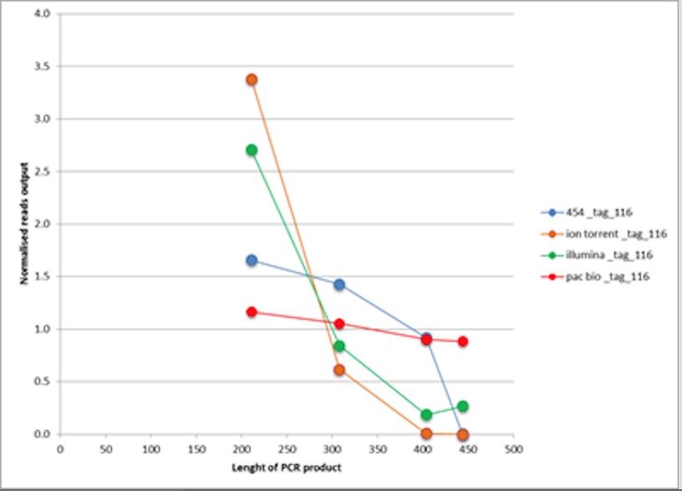
Size-related bias in amplicon-seq
Courtesy Mikael Brandström Durling, Forest Mycology and Pathology, SLU

Slide 32
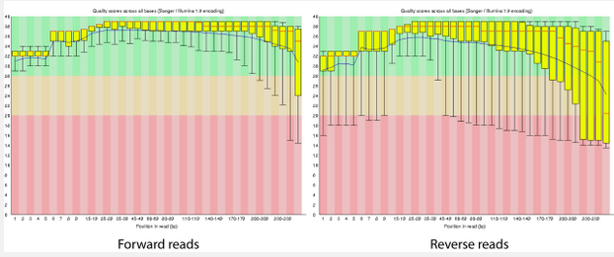
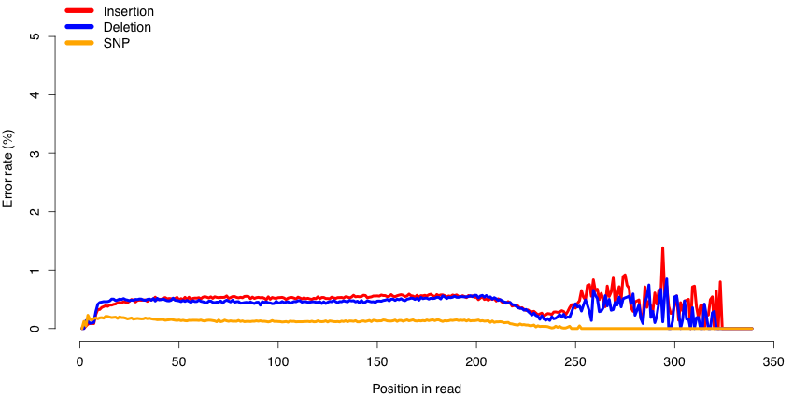
When you sequence an amplicon…
On MiSeq
FW read
RW read
On Ion
FW read

Slide 33
Main types of equipment & applications
Illumina HiSeq
Illumina Xten
Illumina MiSeq
Short paired reads
HIGH throughput
Human WGS
mRNA and miRNA
De novo transcriptome
Exome
ChIP-seq
Short amplicons
Methylation
Ion Torrent PGM
Ion Proton
Ion S5 XL
Short single-end reads
FAST throughput
mRNA and miRNA
Exome
ChIP-seq
Short amplicons
Gene panels
Clinical samples
PacBio RSII
Ultra-long reads
FAST throughput
Long amplicons
Re-sequencing
De novo sequencing
Novel isoform discovery
Fusion transcript analysis
Haplotype phasing
Clinical samples

Slide 34
What is The BEST?

Slide 35
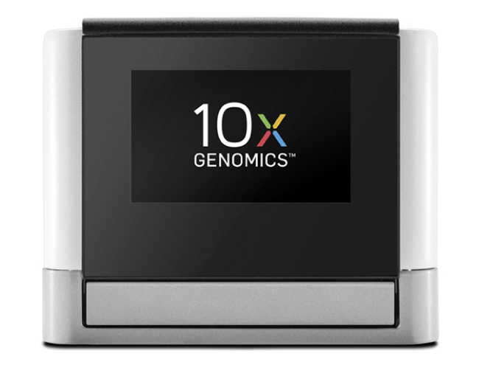
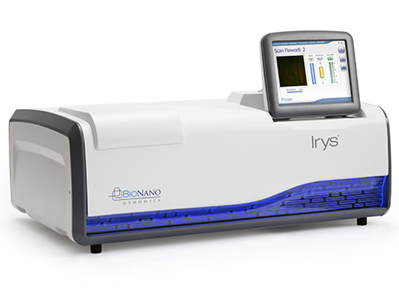
Other technologies for scaffolding of genomes
10x Chromium -> Illumina sequencing
BioNano Irys, optical mapping

Slide 36
SAMPLE QUALITY REQUIREMENTS

Slide 37
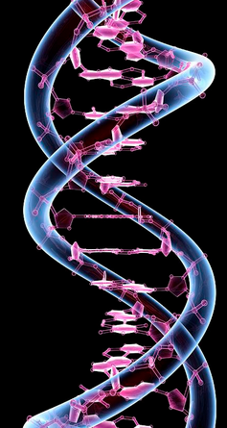
Sample prep: take home message
PCR-quality sample and
NGS-quality sample
are two completely different things

Slide 38
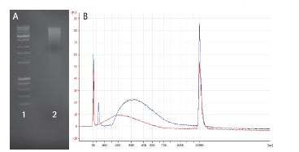
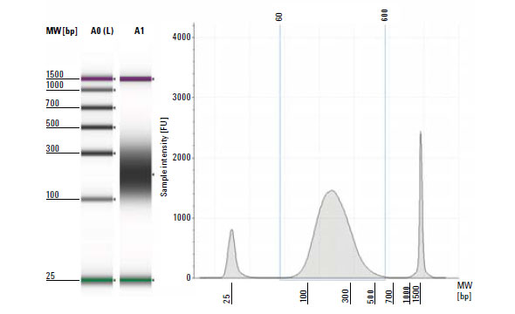
Making an NGS library
DNA QC – paramount importance
Sharing & size selection
Amplification
Ligation of sequencing adaptors, technology specific

Slide 39
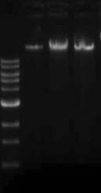
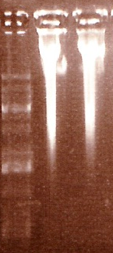
DNA quality
requirements
Some DNA left in the well
Sharp band of 20+kb
No sign of proteins
No smear of degraded DNA
No sign of RNA
NanoDrop:
260/280 = 1.8 – 2.0
260/230 = 2.0 – 2.2
Qubit or Picogreen:
10 kb insert libraries: 3-5 ug
20 kb insert libraries: 10-20 ug

Slide 40
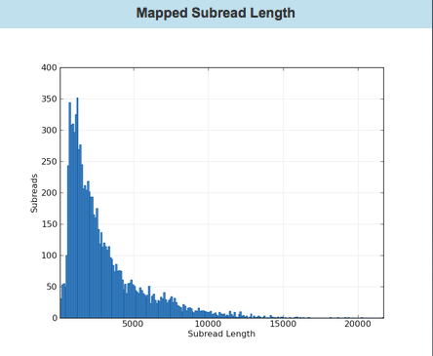
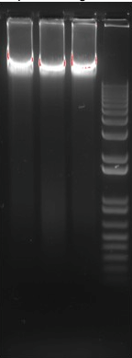
Example:

Slide 41
What do absorption ratios tell us?
Pure DNA 260/280: 1.8 – 2.0
< 1.8:
Too little DNA compared to other components of the solution; presence of organic contaminants: proteins and phenol; glycogen - absorb at 280 nm.
> 2.0:
High share of RNA.
Pure DNA 260/230: 2.0 – 2.2
<2.0:
Salt contamination, humic acids, peptides, aromatic compounds, polyphenols, urea, guanidine, thiocyanates (latter three are common kit components) – absorb at 230 nm.
>2.2:
High share of RNA, very high share of phenol, high turbidity, dirty instrument, wrong blank.
Photometrically active contaminants:
phenol, polyphenols, EDTA, thiocyanate, protein,
RNA, nucleotides (fragments below 5 bp)

Slide 42
How to make a correct measurement
Low concentration
High concentration
DNA
solution
Thaw DNA completely
Mix gently (never vortex!)
Put the sample on a thermoblock: 37°C, 15-30 min
Mix gently
Dilute 1:100 (if HMW)
Mix gently
Make a measurement with an appropriate blank
NANODROP is Bad. Point.
Use Qubit, or PicoGreen.

Slide 43
Let’s get philosophical

Slide 44
Since the beginning of Genomics:
First genome: virus φ X 174 - 5 368 bp (1977)
First organism: Haemophilus influenzae - 1.5 Mb (1995)
First eukaryote: Saccharomyces cerevisiae - 12.4 Mb (1996)
First multicellular organism: Cenorhabditis elegans - 100 MB (1998-2002)
First plant: Arabidopsis thaliana - 157 Mb (2000)

Slide 45
… prices go down
Human genome project, 2007
Genome of Craig Wenter costs 70 mln $
Sanger’s sequencing
Genome of James Watson costs 2 mln $
454 pyrosequencing
Ultimate goal: 1000 $ / individual
Almost there! (1200 $)

Slide 46
… paradigm change
From single genes to complete genomes
From single transcripts to whole transcriptomes
From single organisms to complex metagenomic pools
From model organisms to the species you are studying
Personal genome = personalized medicine

Slide 47
… scientific value diminishes
IF 31.6
IF 2.9

Slide 48
Main challenge - DATA ANALYSIS and DATA STORAGE
!
Data analysis
$
http://finchtalk.geospiza.com
Sequencing
=> More bioinformaticians to people!

Slide 49
NGI-portal

Slide 50
Good reading:
http://journals.plos.org/plosbiology/article?id=10.1371/journal.pbio.1001744

Slide 52
National Genomics Infrastructure
SciLifeLab, Stockholm
SciLifeLab, Uppsala
Mid 2010
Uppmax, Uppsala

Slide 53
NGI-SciLifeLab is one of the most well-equipped
NGS sites in Europe
10 Illumina HiSeq Xten
17 Illumina HiSeq 2000/2500
3 Illumina MiSeq
1 Illumina NextSeq
2 Life Technologies Ion Torrent
6 Life Technologies Ion Proton
2 Pacific Biosciences RSII
2 Sanger ABI3730
1 Argus Whole Genome Map. Syst.
2 Oxford Nanopore MinIon
Notes:
NGI is one of the most well equipped NGS site in Europe. We use different technologies which makes it possible to find most appropriate solution for different type of projects
53

Slide 54
https://ngisweden.scilifelab.se/

Slide 55
What happens then?
NGI Project coordinators meet twice a week via Skype
Ulrika Ellenor
Liljedahl Devine
SNP&SEQ, Uppsala node
Mattias Beata
Ormestad Werne Solenstam
Stockholm Node
Olga
Vinnere Pettersson
UGC, Uppsala Node
Project distribution is based on:
Wish of PI
Type of sequencing technology
Type of application
Queue at technology platforms
Project is then assigned to a certain node and a coordinator contacts the PI

Slide 56
Projects at CMS
3. Access to genomics platform
Project meeting
What we can help you with:
Design your experiment based on the scientific question.
Chose the best suited application for your project.
Find the most optimal sequencing setup.
Answer all questions about our technologies and applications, as well as bioinformatics.
In special cases, we can give extra-support with bioinformatics analysis – development of novel methods and applications

Slide 57
Need help with data analysis?
NBIS.se

Slide 58
QUESTIONS?

