Slide 1
Next Generation Sequencing: Overview and Challenges
Olga Vinnere Pettersson, PhD
National Genomics Infrastructure hosted by ScilifeLab,
Uppsala Node (UGC)
Version 6.3

Slide 2
Outline
INTRO
Sequencing service at NGI-SciLifeLab
Short history of NGS
NGS general knowledge
Current technologies
Main applications
NGS Challenges
Sequencing artefacts
NGS sample quality requirements
Philosophical reflection

Slide 3
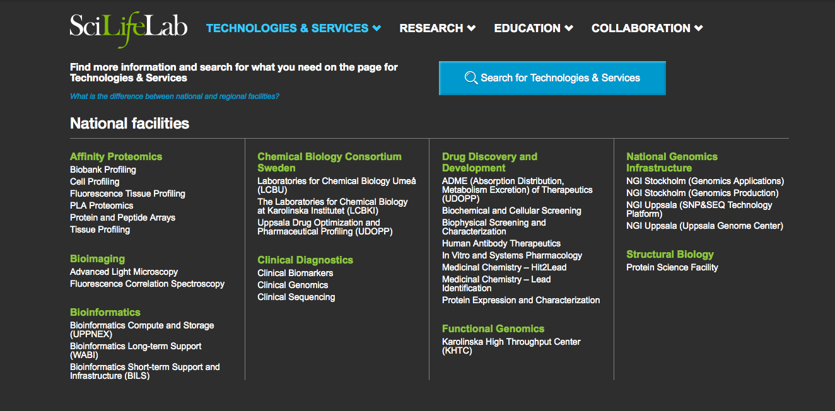

Slide 4
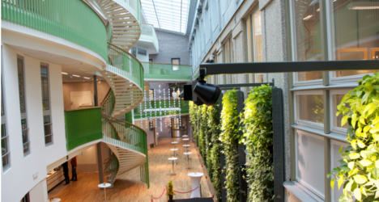
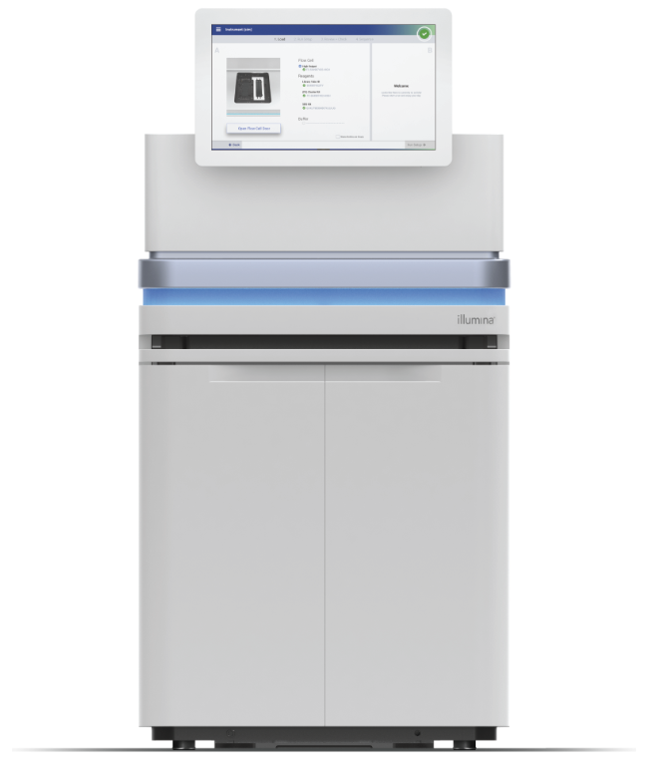
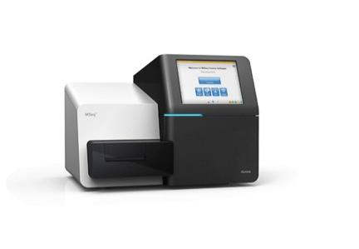
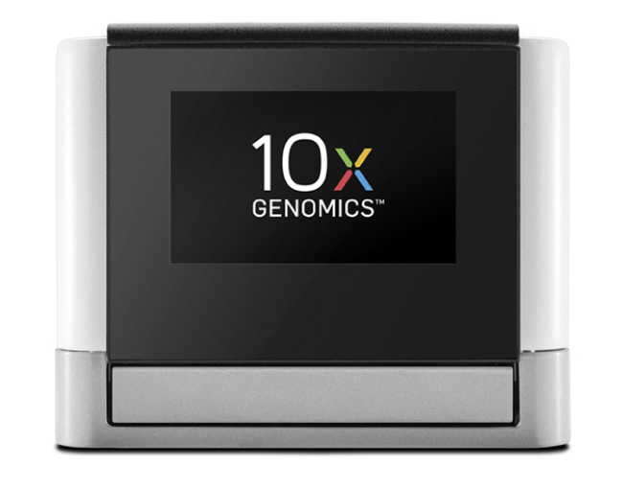
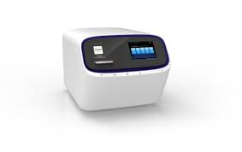
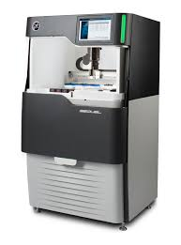
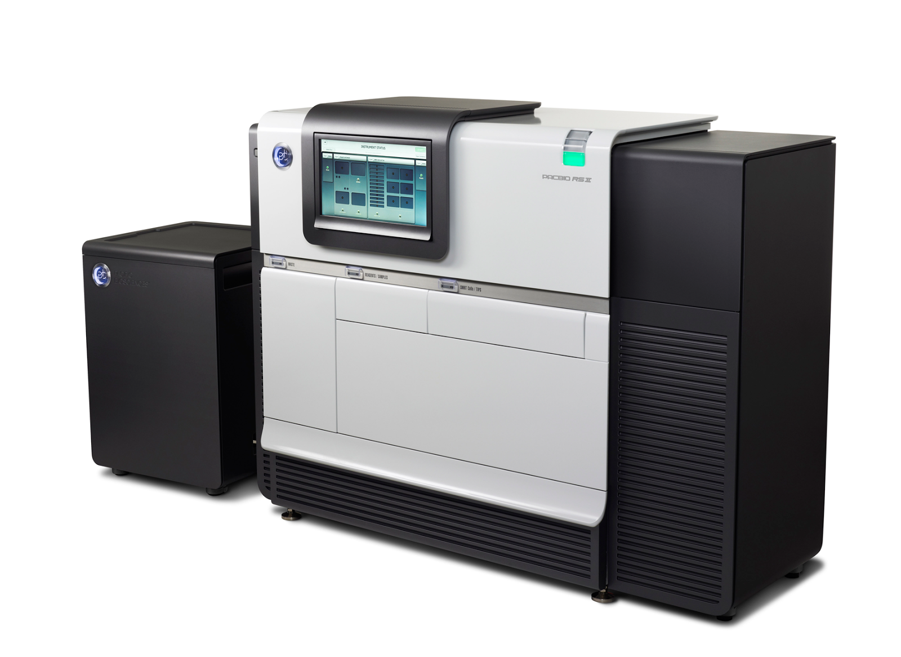
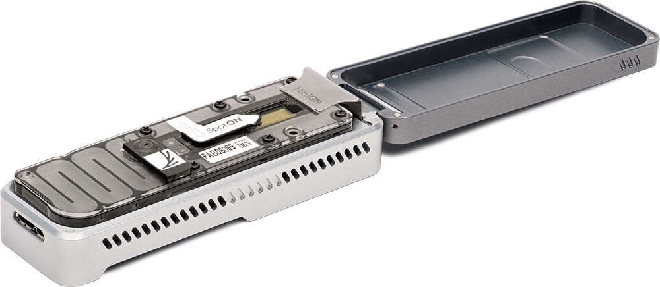
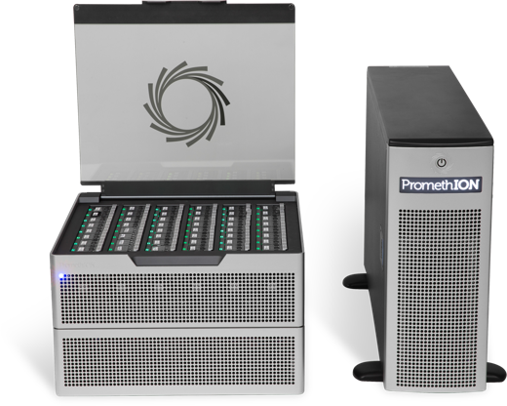

Slide 5
We are non-profit
We have technology and knowledge
We want to help you to do GREAT research
We do not want co-authorship
Let us help YOU

Slide 6
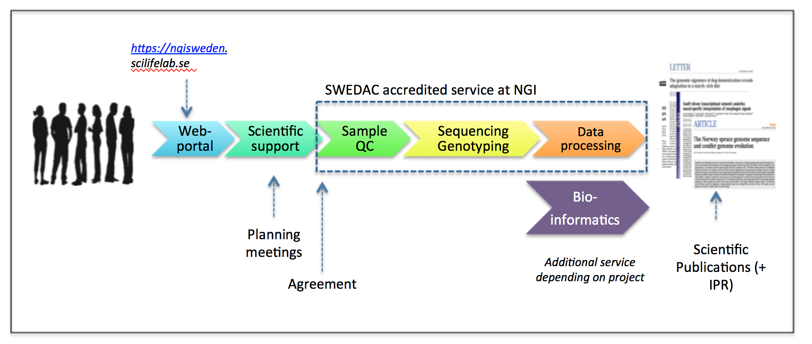
Project handling at NGI

Slide 7
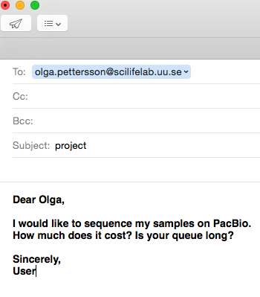
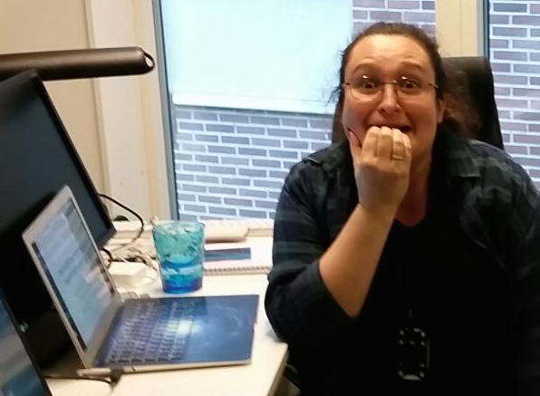
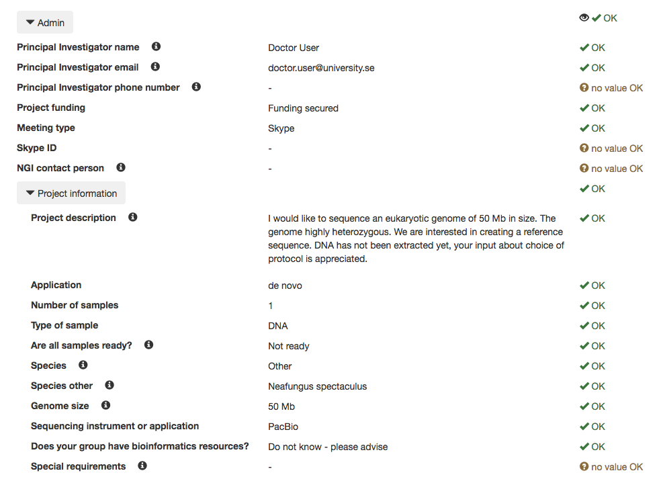
How does a project go? Project request
Notes:
Learning curve: hur ska projektet gå till
Innan submission
QC
Portalen
Submission forms och vad behövs
Sample: De novo
DNA qual
Titeringsserie: längd, re-calculating # celler
Sekvensering: statistik på en körning
Assembly: Falcon & HGAP
Vad levereras och hur
Sample: Amplicon seq & capture
Size selection
Iso-seq: second strand synthesis?
Base mods: proks inga problem
Euk – inte än

Slide 8
Short History of NGS

Slide 9
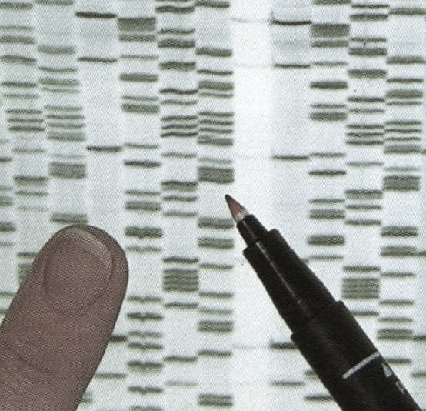
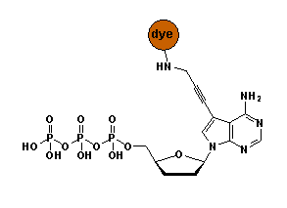
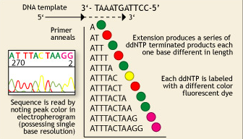
Once upon a time…
Fredrik Sanger and Alan Coulson
Chain Termination Sequencing (1977)
Nobel prize 1980
Principle:
SYNTHESIS of DNA is randomly TERMINATED at different points
Separation of fragments that are 1 nucleotide different in size
!
Lack of OH-group at 3’ position of deoxyribose
1 molecule sequenced at a time = 1 read
Capillary sequencer: 384 reads per run

Slide 10
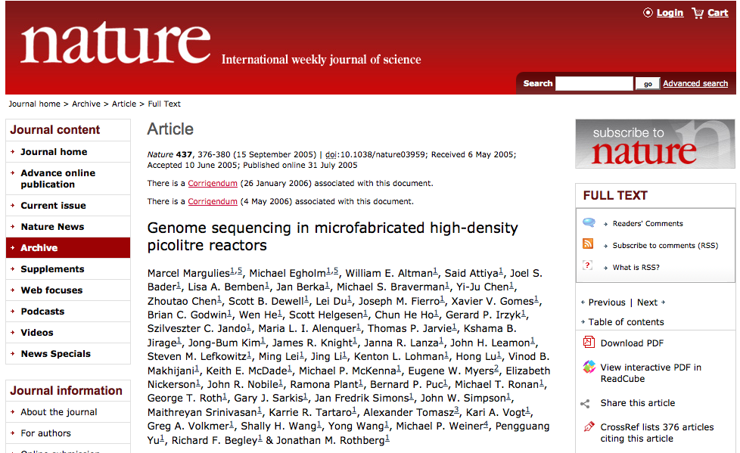
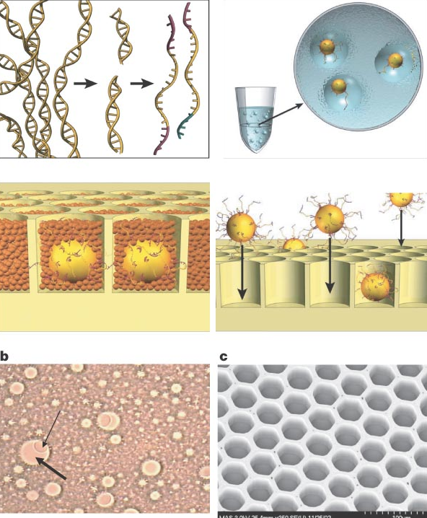
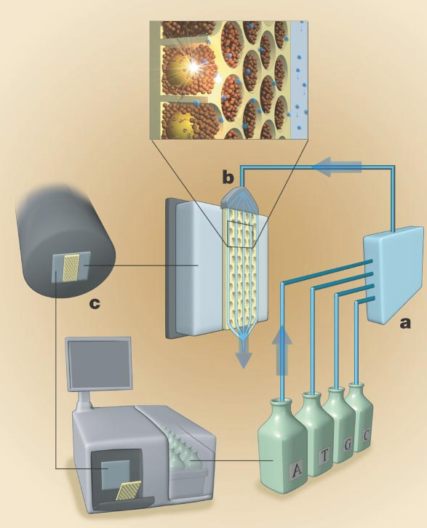
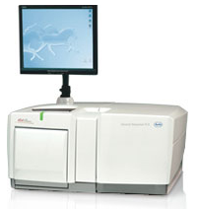
2006: NGS was borne
Thousands of molecules sequenced in parallel
1 mln reads sequenced per run
Roche 454 GS FLX

Slide 11
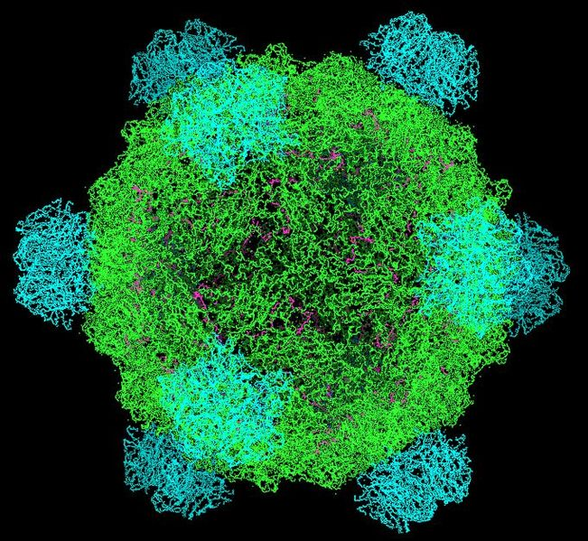
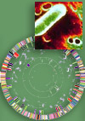
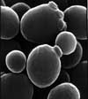
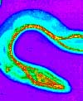
Since the beginning of Genomics:
First genome: virus φ X 174 - 5 368 bp (1977)
First organism: Haemophilus influenzae - 1.5 Mb (1995)
First eukaryote: Saccharomyces cerevisiae - 12.4 Mb (1996)
First multicellular organism: Cenorhabditis elegans - 100 MB (1998-2002)
First plant: Arabidopsis thaliana - 157 Mb (2000)

Slide 12
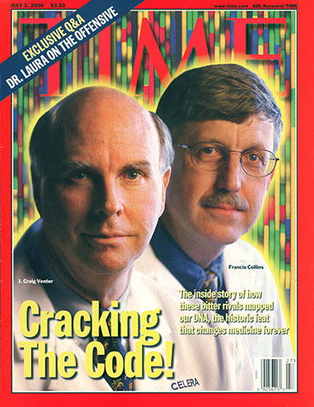
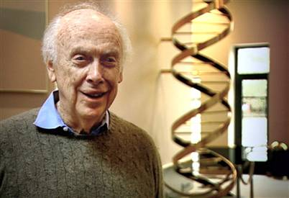
… prices go down
Human genome sequencing:
2004: Genome of Craig Wenter costs 70 mln $
Sanger’s sequencing
2007: Genome of James Watson costs 2 mln $
454 pyrosequencing
2014: Ultimate goal: 1000 $ / individual
2016: Illumina Xten: Almost there! (1200 $)
2017: NovaSeq: ”Hold my beer…” (100 $)

Slide 13
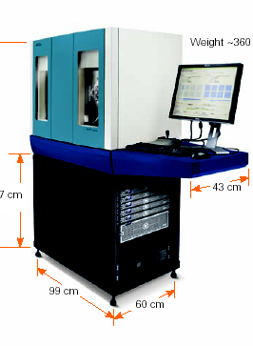
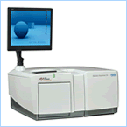
… paradigm changes
From single genes to complete genomes
From single transcripts to whole transcriptomes
From single organisms to complex metagenomic pools
From model organisms to the species you are studying
Personal genome = personalized medicine

Slide 14
… scientific value diminishes
IF 31.6
IF 2.9

Slide 15
Current Technologies

Slide 16
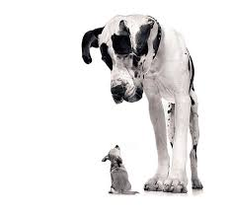
Read length

Slide 17
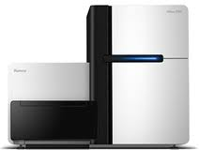
Illumina
Instrument | Yield and run time | Read Length | Error rate | Error type
HiSeq2500 | 120 Gb – 600 Gb 27h or standard run | 110x110 (250x250) | 0.1% | Subst
MiSeq | 540 Mb – 15 Gb (4 – 48 hours) | up to 350x350 | 0.1% | Subst
HiSeqXten | 800 Gb - 1.8 Tb (3 days) | 150x150 | “ | “
NovaSeq 6000 | 250 Gb – 3 Tb | 150x150 | “ | “
Main applications
Whole genome, exome and targeted reseq
Transcriptome analyses
Methylome and ChiPSeq
Rapid targeted resequencing (MiSeq)
Human genome seq (Xten)

Slide 18
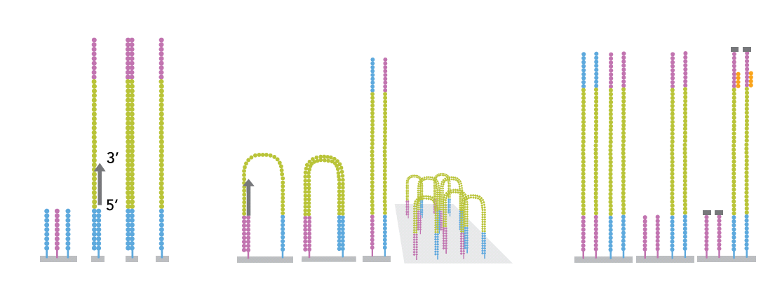
Illumina: bridge amplification
200M fragments per lane
Bridge amplification
Ends with blocking of free 3’-ends and
hybridisation of sequencing primer
Notes:
De fragment som ska sekvensera amplifiera I flödescellen för att möjliggöra detektion av signalerna från sekvensningen. Detta sker I en så kallad klulstergenerering, där de fragment som ska sekvenseras kopieras ca 1000x på en liten delyta och varje fragment då bildar ett sk klluster.
Förenklad bild, sker samtidigt för ca 200M fragment per lane I flödescellen.
Adaptern på sekvensningsbiblioteken binder till komplementära sekvenser på ytan I flödescellen. Den komplementära sekvensen fungerar

Slide 19
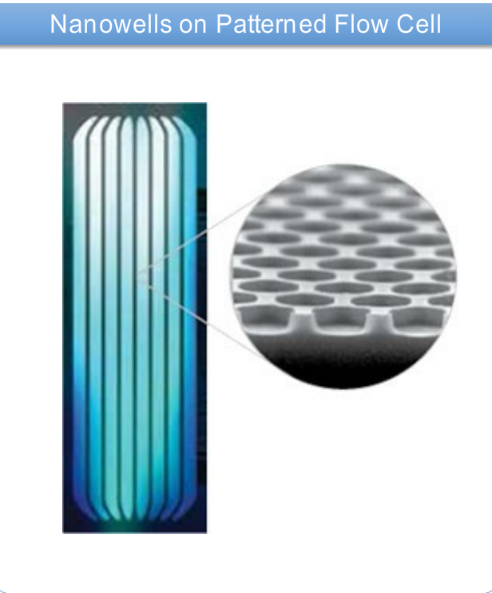
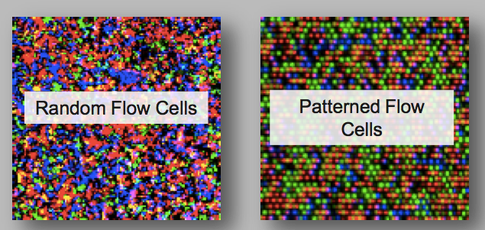
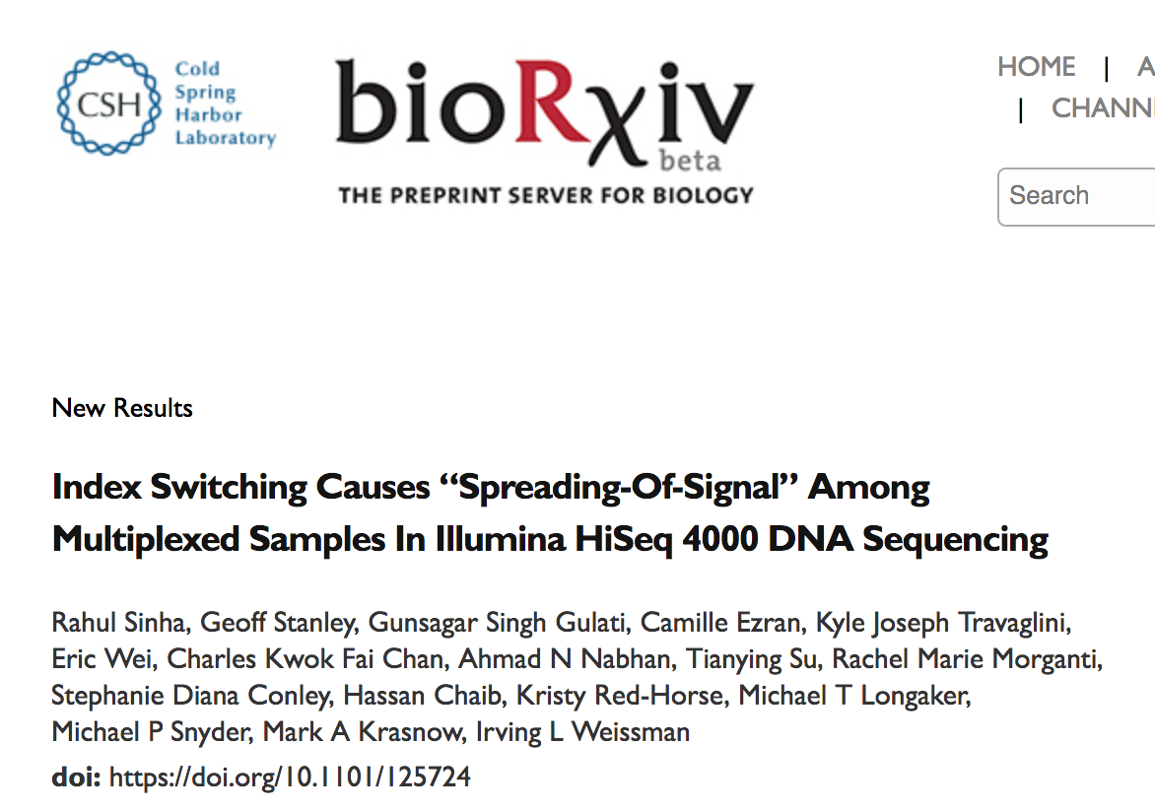
Illumina: ExAmp = black box

Slide 20
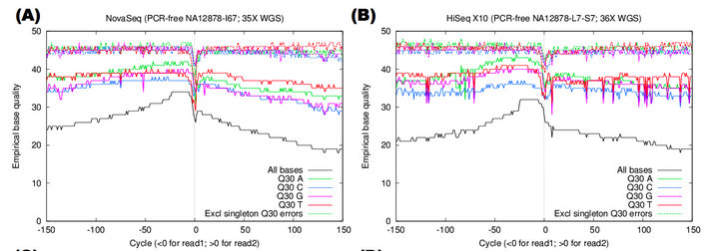
NovaSeq 6000
NGI has five instruments
Flexible and scalable using multiple flow cell types
Quick and easy operation using RFID labeled reagent cassettes
Onboard clustering and automatic washing minimises hands on time during runs
2 color chemistry
T=Green C=Red A=Green/Red G=no signal

Slide 21
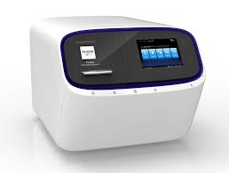
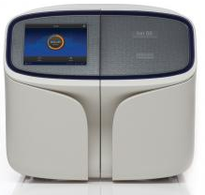
Ion
Chip determines throughput | Yield - run time | Read Length
314, 316, 318 (PGM) | 0.1 – 1 Gb, 3 hrs | 200 – 400 bp
P-I (Proton) | 10 Gb, 4 hrs | 200 bp
510, 520, 530, 540, 550 (S5XL) | 1 Gb – 15 Gb 3 hrs (two chips per day) | 200 - 600 bp
Main applications
Microbial and metagenomic sequencing
Targeted re-sequencing (gene panels)
Clinical sequencing

Slide 22
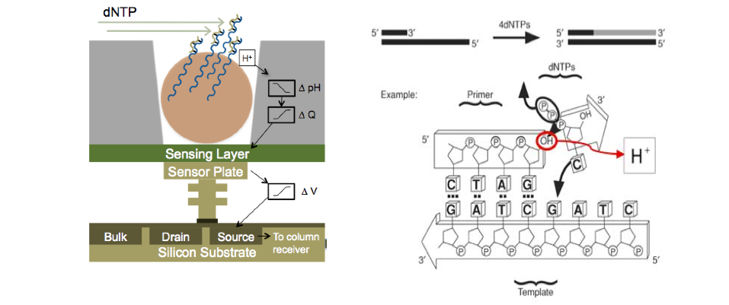
Ion Torrent - H⁺ ion-sensitive field effect transistors
bead

Slide 23
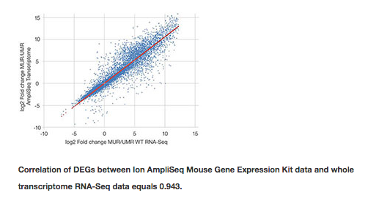
Main Ion technology application: AmpliSeq
Multiplex PCR to a number of targets (up to 20 000)
Very fast workflow (4-8 hours), perfect for clinics
Automated analysis (IonReporter)
10-50 ng input (most panels work with FFPE)
Custom panels on demand, any genome
Panels:
Human exome
Human transcriptome
Mouse transcriptome
16S
Cancer Hotspot
Comprehensive Cancer
Lung and Colon
Blood
Heart, etc

Slide 24
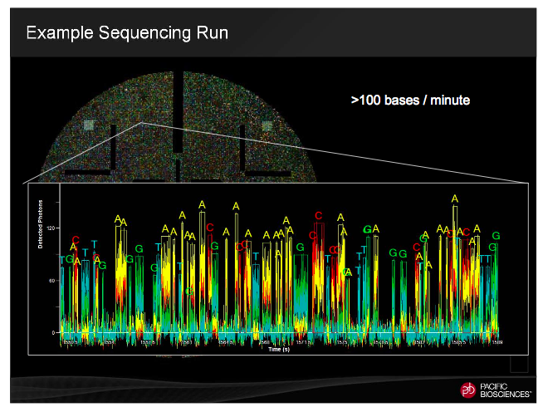
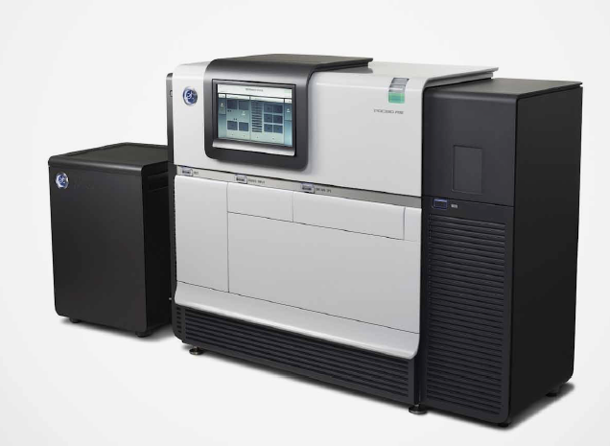
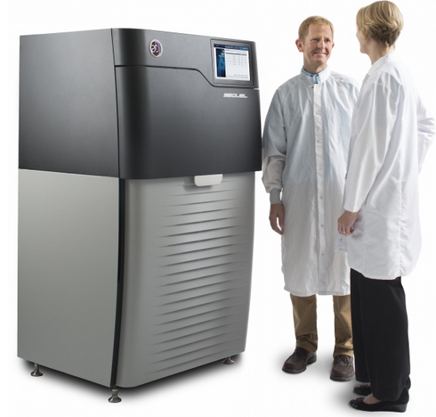
PacBio
Instrument | Yield/cell and run time | Read Length | Error rate | Error type
RSII | 250 Mb – 1.8 Gb 30 - 600 min | 250 bp – 60 kb (78 kb) | 15 % (single pass) 0.0001% (circular consensus) | Indels, random
SEQUEL | 2-14 Gb 30-2400 min | 250 bp – 80 kb (160 kb) | as RSII | Indels, random
Single-Molecule, Real-Time DNA sequencing

Slide 25
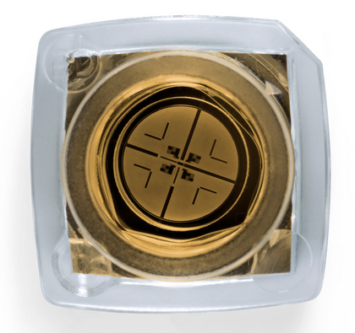
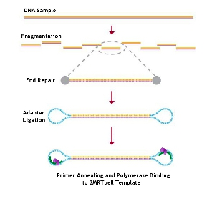
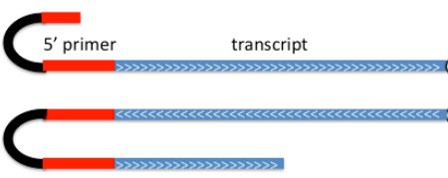
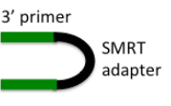
PacBio: SMRT - technology
SMRT =
Single Molecule Real Time

Slide 27
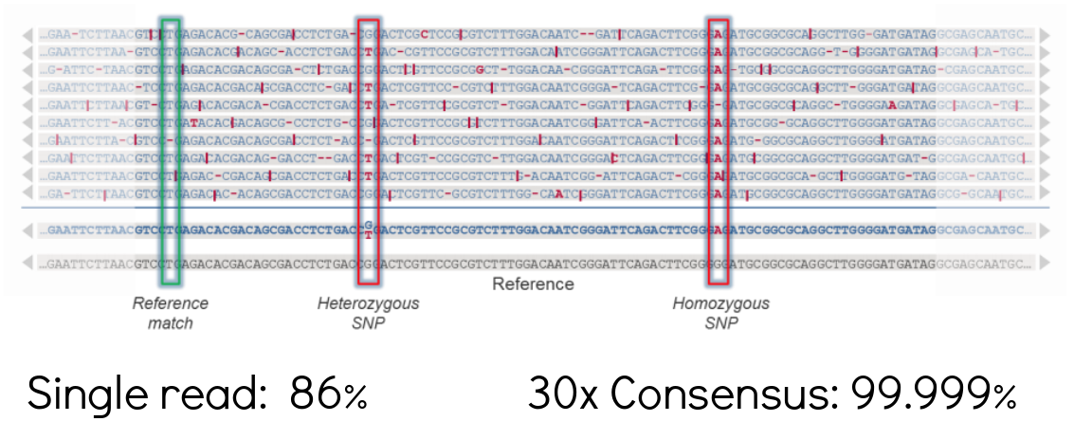
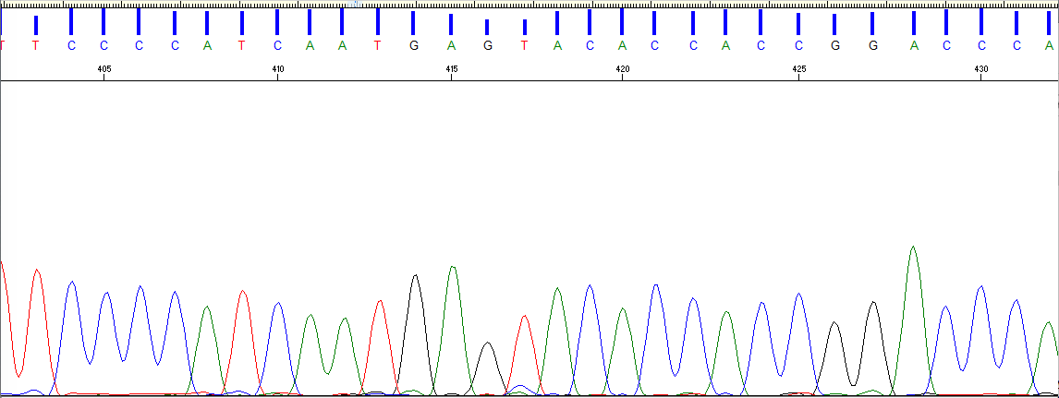
SMRT sequencing: common misconceptions
High error rate?
Irrelevant, because errors are random
Depending on coverage
Examples:
8 Mb genome, 8 SNPs detected
65 kb construct: 100% correct sequence
Detection of low frequency mutations
High price?
Bioinfo-time to assemble short reads
Not for small genomes
Better assembly quality
Single-molecule reads without PCR-bias
Bioinfo-time to assemble long reads

Slide 28
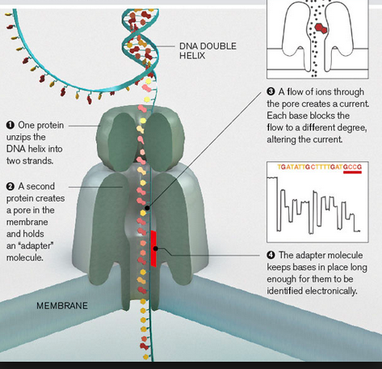
Oxford Nanopore
Flow Cells run in parallel | Yield - run time
MinION (1) | 1 – 10 Gb / cell
GridION (5) | 5 – 50 Gb / 5 cells
PromethION (12 - 24 - 48) | 20 – 100 Gb / cell
Reads up to 6-8 Gb
10-15% error rate
Life time 5 days
Longest reads: beyond 1 Mb

Slide 29
10x Genomics (Chromium)
Fragment length: 50 kb – 100+ Kb

Slide 30
NGS Applications

Slide 31
NGS/MPS applications
Whole genome sequencing:
De novo sequencing
Re-sequencing
Transcriptome sequencing:
mRNA-seq
miRNA
Isoform discovery
Target re-sequencing
Exome
Large portions of a genome
Gene panels
Amplicons

Slide 32
Whole genome sequencing: de novo
De novo: used to assemble a genome without previous reference
Conventional strategy (Golden Standard):
Illumina 50x sequencing on HiSeqX or NovaSeq, several insert sizes (+ Mate Pairs)
Current recommendation* (Platinum genome):
100x PacBio (ONT) only + Hi-C (coverage depends on heterozygocity)
Plus RNA-seq data for annotation
* 2019-02-05

Slide 33
De novo – do it with long reads!
Beware: up to 80% of novel structural variants can be missing from short-read data.
Sequence fewer genomes,
but with long reads

Slide 34
Transcriptome sequencing (RNA-seq)
TOTAL RNA
mRNA
Dif.ex.
Annotation
Splice isoforms
Non-codingRNA
miRNA
Transcriptional regulation

Slide 35
RNA-seq experimental setup
mRNA only: any kit
mRNA and miRNA: only specialized kits
Always use DNase!
RIN value above 8.
CONTROL vs experimental conditions
Biological replicates: 4 strongly recommended

Slide 36
RNA-seq with long reads
PacBio Iso-seq: full-length transcriptome seq
Coming soon: direct RNA-seq on ONT

Slide 37
Main types of equipment & applications
Illumina HiSeq
NextSeq, HiSeqX10, MiSeq,
MiniSeq, NovaSeq
Short paired reads
HIGH throughput
Human WGS
Re-sequencing 30x
mRNA and miRNA
De novo transcriptome
Exome
ChIP-seq
Short amplicons
Methylation
Ion S5 XL
Short single-end reads
FAST throughput
mRNA and miRNA
Exome
ChIP-seq
Short amplicons
Gene panels
Clinical samples
PacBio RSII
SEQUEL
Ultra-long reads
FAST throughput
Long amplicons
Re-sequencing
De novo sequencing
Novel isoform discovery
Fusion transcript analysis
Resolving haplotypes
Clinical samples

Slide 38
NGS Challenges Sequencing artefacts Sample prep Data analysis Making sense of NGS data

Slide 39
Sequencing artefacts: what are they?
Sequencing a representative, completely randomized subsample:
it starts with input material
What textbook tells you:
Brutal reality:

Slide 40
Sequencing artefacts: what are they?
Sequencing a representative, completely randomized subsample:
continues with library preparation
Input sample
Loosing molecules all the way
Shearing and size-selection
Less material -> more amplification cycles

Slide 41
Sequencing artefacts: what are they?
PCR bias – important source of sequencing artefacts
PCR steps involved in any short read NGS:
Library amplification
Amplification during templating (Illumina – on glass; Ion – emPCR)
Main PCR bias:
1. Size: shorter fragments amplify faster -> higher sequencing signal and coverage
2. Polymerase errors
slippage in low complexity regions
incorporation of erroneous bases & indels
3. GC-bias (fragments with high GC diminish to 1/10th from initial amount)

Slide 42
Sequencing artefacts: what are they?
PCR bias – important source of sequencing artefacts
Clusters with shorter fragments grow faster ->
quality signal from smaller clusters worsens
GC bias &
genome coverage
Heavily amplified library
PCR-free library

Slide 43
Sequencing artefacts: what are they?
PCR bias – important source of sequencing artefacts
Polymerase slippage – low complexity regions
Huntington’s disease:
Inherited disorder resulting in brain cell death
Decline of motoric and cognitive functions
Common onset: 30-50 years of age
No cure
Causative genetic variant: CAG-repeat expansion in HTT gene

Slide 44
Sample prep: take home message
PCR-quality sample and
NGS-quality sample
are two completely different things

Slide 45
DNA quality and inhibition of sequencing
Short-read technologies: PCR inhibition
Long-read technologies are PCR-free, but one sequences native DNA “as is”.
Carry-over from hosts:
Proteins
Polyphenols
Secondary metabolites
Pigments
Polysaccharides
Metals
Carry-over from extraction:
Phenol
Guanidinium
Ethanol
EDTA
Physical inhibiting factors – debris
Modes of action:
Binding to DNA
Enzyme inhibition
Hamilton & Arya, Nat. Prod. Rep., 2012, 29, 134-143

Slide 46
The DNA extraction process
1
2

Slide 47
Example:

Slide 48
What do absorption ratios tell us?
Pure DNA 260/280: 1.8 – 2.0
< 1.8:
Too little DNA compared to other components of the solution; presence of organic contaminants: proteins and phenol; glycogen - absorb at 280 nm.
> 2.0:
High share of RNA.
Pure DNA 260/230: 2.0 – 2.2
<2.0:
Salt contamination, humic acids, peptides, aromatic compounds, polyphenols, urea, guanidine, thiocyanates (latter three are common kit components) – absorb at 230 nm.
>2.2:
High share of RNA, very high share of phenol, high turbidity, dirty instrument, wrong blank.
Photometrically active contaminants:
phenol, polyphenols, EDTA, thiocyanate, protein,
RNA, nucleotides (fragments below 5 bp)

Slide 49
How to make a correct measurement
Thaw DNA completely
Mix gently (never vortex!)
Put the sample on a thermoblock: 37°C, 15-30 min
Mix gently
Dilute 1:100 (if HMW)
Mix gently
Make a measurement with an appropriate blank
NANODROP is Bad. Point.
Use Qubit, or PicoGreen.
LMW-DNA
HMW-DNA

Slide 50
BIG DATA
2025 projection: data storage needs
1 petabyte = 10¹⁵ bytes
1 exabyte = 10¹⁸ bytes
2-40 exabytes/year
1-2 exabytes/year
1 exabyte/year
Large Hadron Collider
42 petabytes/year
1-17 petabytes/year

Slide 51
Now, analysis
Severe shortage of bioinformaticians

Slide 52
Making statistically-significant sense out of data
Scaling up statistics & Multiple testing correction
Microarrays: 10-100k SNPs
Bonferroni correction = 0.05/10⁴ = 5*10⁻⁶
(max p-value for SNP to be significant)
Sequencing: 1-10 mln SNP
Bonferroni correction = 0.05/(5*10⁶) = 1*10⁻⁸
=> With more information we lose statistical power
1 SNP = 1 trait
vs
100 SNPs = 1 trait

Slide 53
Never forget: Correlation vs Causation
Reduction in export of fresh lemons from Mexico causes significant reduction
of highway traffic fatality rates in the US!

Slide 54
2 minutes of philosophy

Slide 55
Genome is not a linear string of bases!!
Mutations in coding regions only
Transcriptional & post-transcriptional regulation
Epigenetics
Proximity in chromosomes

Slide 56
Blind men & an elephant

Slide 57
Application challenges: extremely fast progress in the field
Time to do biological experiments: 1 - 2 years
Time to do sequencing: 2 - 6 months
Time to analyze data: 2 months – 1 year
Time to write a paper: 3 – 6 months
Time to wait for review process: 1 – 3 months
Re-writing the paper: 1 - 3 months
Publishing: 1 - 2 months
Time between sequencing and paper is 1 - 2.5 years

Slide 58
http://ugc.igp.uu.se/news-and-events
https://ngiseminars.wixsite.com/longread2019

Slide 59
Thanks for listening! Questions?
support@ngisweden.se

